Slide 1
Module 4
Spring Core

Slide 2
Content to be discussed
Spring Framework
Spring AOP
Spring MVC
Database
Spring REST API
Spring Boot REST

Slide 3
Spring Framework
developed by Rod Johnson in 2003. first released under the Apache 2.0 license in June 2003.
Spring framework makes the easy development of JavaEE application.
It is helpful for beginners and experienced persons.
Spring is a lightweight framework.
It can be thought of as a framework of frameworks because it provides support to various frameworks such as Struts, Hibernate, Tapestry, EJB, JSF, etc.
The framework, in broader sense, can be defined as a structure where we find solution of the various technical problems.
The Spring framework comprises several modules such as IOC, AOP, DAO, Context, ORM, WEB MVC etc.

Slide 4
Inversion Of Control (IOC) and Dependency Injection
These are the design patterns that are used to remove dependency from the programming code. They make the code easier to test and maintain. Let's understand this with the following code:
class Employee{
Address address;
Employee(){
address=new Address();
}
}

Slide 5
IOC
In such case, there is dependency between the Employee and Address (tight coupling). In the Inversion of Control scenario, we do this something like this:
class Employee{
Address address;
Employee(Address address){
this.address=address;
}
}
Thus, IOC makes the code loosely coupled. In such case, there is no need to modify the code if our logic is moved to new environment.
In Spring framework, IOC container is responsible to inject the dependency. We provide metadata to the IOC container either by XML file or annotation.
Advantage of Dependency Injection
makes the code loosely coupled so easy to maintain
makes the code easy to test

Slide 6
Advantages of Spring Framework
1) Predefined Templates - provides templates for JDBC, Hibernate, JPA etc. technologies. So there is no need to write too much code. It hides the basic steps of these technologies.
2) Loose Coupling - The Spring applications are loosely coupled because of dependency injection.
3) Easy to test - The Dependency Injection makes easier to test the application. The EJB or Struts application require server to run the application but Spring framework doesn't require server.
4) Lightweight - because of its POJO implementation. doesn't force the programmer to inherit any class or implement any interface. That is why it is said non-invasive.
5) Fast Development - The Dependency Injection feature of Spring Framework and it support to various frameworks makes the easy development of JavaEE application.
6) Powerful abstraction - provides powerful abstraction to JavaEE specifications such as JMS, JDBC, JPA and JTA.
7) Declarative support - It provides declarative support for caching, validation, transactions and formatting.

Slide 7
Spring Modules
The Spring framework comprises of many modules such as core, beans, context, expression language, AOP, Aspects, Instrumentation, JDBC, ORM, OXM, JMS, Transaction, Web, Servlet, Struts etc.
These modules are grouped into Test, Core Container, AOP, Aspects, Instrumentation, Data Access / Integration, Web (MVC / Remoting) as displayed in the following diagram.

Slide 8
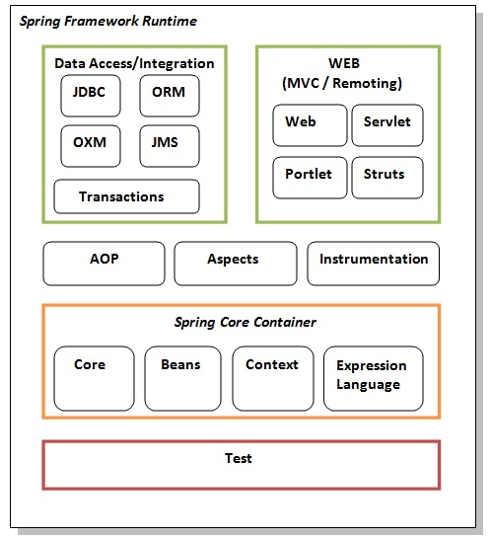
High Level Architecture

Slide 9
Elements of Spring Module
Test - This layer provides support of testing with JUnit and TestNG.
Spring Core Container - contains core, beans, context and expression language (EL) modules.
Core and Beans - These modules provide IOC and Dependency Injection features.
Context - This module supports internationalization (I18N), EJB, JMS, Basic Remoting.
Expression Language - It is an extension to the EL defined in JSP. It provides support to setting and getting property values, method invocation, accessing collections and indexers, named variables, logical and arithmetic operators, retrieval of objects by name etc.
AOP, Aspects and Instrumentation - These modules support aspect oriented programming implementation where you can use Advices, Pointcuts etc. to decouple the code. The aspects module provides support to integration with AspectJ. The instrumentation module provides support to class instrumentation and classloader implementations.
Data Access / Integration - This group comprises of JDBC, ORM, OXM, JMS and Transaction modules. These modules basically provide support to interact with the database.
Web - This group comprises of Web, Web-Servlet, Web-Struts and Web-Portlet. These modules provide support to create web application.

Slide 10
Spring Example
simple steps to create the first spring application. To run this application, we are not using any IDE. We are simply using the command prompt. The simple steps to create the spring application.
create the class
create the xml file to provide the values
create the test class
Load the spring jar files
Run the test class

Slide 11
1) Create Java class
This is the simple java bean class containing the name property only.
package com.javatpoint;
public class Student {
private String name;
public String getName() {
return name;
}
public void setName(String name) {
this.name = name;
}
public void displayInfo(){
System.out.println("Hello: "+name);
}
}
This is simple bean class, containing only one property name with its getters and setters method. This class contains one extra method named displayInfo() that prints the student name by the hello message.

Slide 12
2) Create the XML file
Open the applicationContext.xml file, and write the following code:
<?xml version="1.0" encoding="UTF-8"?>
<beans
xmlns="http://www.springframework.org/schema/beans"
xmlns:xsi="http://www.w3.org/2001/XMLSchema-instance"
xmlns:p="http://www.springframework.org/schema/p"
xsi:schemaLocation="http://www.springframework.org/schema/beans
http://www.springframework.org/schema/beans/spring-beans-3.0.xsd">
<bean id="studentbean" class="com.javatpoint.Student">
<property name="name" value="Vimal Jaiswal"></property>
</bean>
</beans>
The bean element is used to define the bean for the given class. The property subelement of bean specifies the property of the Student class named name. The value specified in the property element will be set in the Student class object by the IOC container.

Slide 13
3) Create the test class
Create the java class e.g. Test. Here we are getting the object of Student class from the IOC container using the getBean() method of BeanFactory. Let's see the code of test class.
package com.javatpoint;
import org.springframework.beans.factory.BeanFactory;
import org.springframework.beans.factory.xml.XmlBeanFactory;
import org.springframework.core.io.ClassPathResource;
import org.springframework.core.io.Resource;
public class Test {
public static void main(String[] args) {
Resource resource=new ClassPathResource("applicationContext.xml");
BeanFactory factory=new XmlBeanFactory(resource);
Student student=(Student)factory.getBean("studentbean");
student.displayInfo();
}
}
The Resource object represents the information of applicationContext.xml file. The Resource is the interface and the ClassPathResource is the implementation class of the Reource interface. The BeanFactory is responsible to return the bean. The XmlBeanFactory is the implementation class of the BeanFactory. There are many methods in the BeanFactory interface. One method is getBean(), which returns the object of the associated class.

Slide 14
4) Load the jar files required for spring framework
There are mainly three jar files required to run this application.
org.springframework.core-3.0.1.RELEASE-A
com.springsource.org.apache.commons.logging-1.1.1
org.springframework.beans-3.0.1.RELEASE-A

Slide 15
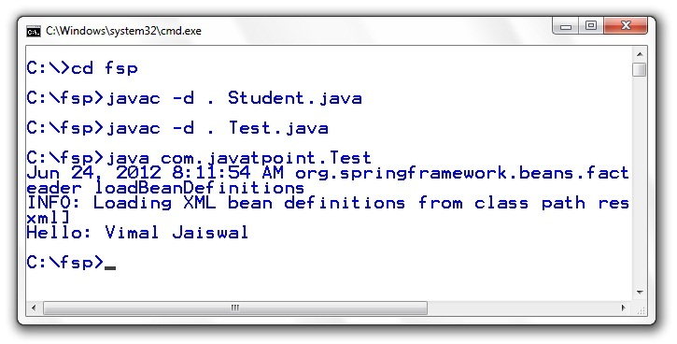
5) Run the test class

Slide 16
Creating spring application in Eclipse IDE
simple steps to create the spring application in Eclipse IDE.
create the java project
add spring jar files
create the class
create the xml file to provide the values
create the test class

Slide 17
1) Create the Java Project
Go to File menu - New - project - Java Project. Write the project name e.g. firstspring - Finish. Now the java project is created.

Slide 18
2) Add spring jar files
There are mainly three jar files required to run this application.
org.springframework.core-3.0.1.RELEASE-A
com.springsource.org.apache.commons.logging-1.1.1
org.springframework.beans-3.0.1.RELEASE-A
For the future use, You can download the required jar files for spring core application.
download the core jar files for spring
download the all jar files for spring including aop, mvc, j2ee, remoting, oxm, etc.
To run this example, you need to load only spring core jar files.
To load the jar files in eclipse IDE, Right click on your project - Build Path - Add external archives - select all the required jar files - finish..

Slide 19
3) Create Java class
In such case, we are simply creating the Student class have name property. The name of the student will be provided by the xml file. It is just a simple example not the actual use of spring. We will see the actual use in Dependency Injection chapter. To create the java class, Right click on src - New - class - Write the class name e.g. Student - finish. Write the following code:
package com.javatpoint;
public class Student {
private String name;
public String getName() {
return name;
}
public void setName(String name) {
this.name = name;
}
public void displayInfo(){
System.out.println("Hello: "+name);
}
}
This is simple bean class, containing only one property name with its getters and setters method. This class contains one extra method named displayInfo() that prints the student name by the hello message.

Slide 20
4) Create the xml file
To create the xml file click on src - new - file - give the file name such as applicationContext.xml - finish. Open the applicationContext.xml file, and write the following code:
<?xml version="1.0" encoding="UTF-8"?>
<beans
xmlns="http://www.springframework.org/schema/beans"
xmlns:xsi="http://www.w3.org/2001/XMLSchema-instance"
xmlns:p="http://www.springframework.org/schema/p"
xsi:schemaLocation="http://www.springframework.org/schema/beans
http://www.springframework.org/schema/beans/spring-beans-3.0.xsd">
<bean id="studentbean" class="com.javatpoint.Student">
<property name="name" value="Vimal Jaiswal"></property>
</bean>
</beans>
The bean element is used to define the bean for the given class. The property subelement of bean specifies the property of the Student class named name. The value specified in the property element will be set in the Student class object by the IOC container.

Slide 21
5) Create the test class
Create the java class e.g. Test. Here we are getting the object of Student class from the IOC container using the getBean() method of BeanFactory. Let's see the code of test class.
package com.javatpoint;
import org.springframework.beans.factory.BeanFactory;
import org.springframework.beans.factory.xml.XmlBeanFactory;
import org.springframework.core.io.ClassPathResource;
import org.springframework.core.io.Resource;
public class Test {
public static void main(String[] args) {
Resource resource=new ClassPathResource("applicationContext.xml");
BeanFactory factory=new XmlBeanFactory(resource);
Student student=(Student)factory.getBean("studentbean");
student.displayInfo();
}
}

Slide 22
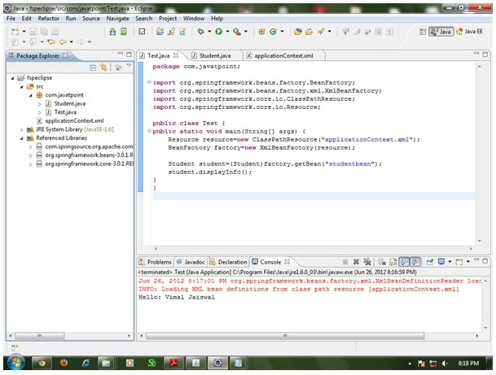
6) Run the application
Now run this class. You will get the output Hello: Vimal Jaiswal.

Slide 23
IoC Container
The IoC container is responsible to instantiate, configure and assemble the objects. The IoC container gets informations from the XML file and works accordingly.
The main tasks performed by IoC container are:
to instantiate the application class
to configure the object
to assemble the dependencies between the objects
There are two types of IoC containers. They are:
BeanFactory
ApplicationContext

Slide 24
Difference between BeanFactory and the ApplicationContext
The org.springframework.beans.factory.BeanFactory and the org.springframework.context.ApplicationContext interfaces acts as the IoC container.
The ApplicationContext interface is built on top of the BeanFactory interface. It adds some extra functionality than BeanFactory such as simple integration with Spring's AOP, message resource handling (for I18N), event propagation, application layer specific context (e.g. WebApplicationContext) for web application. So it is better to use ApplicationContext than BeanFactory.

Slide 25
Using BeanFactory
The XmlBeanFactory is the implementation class for the BeanFactory interface. To use the BeanFactory, we need to create the instance of XmlBeanFactory class as given below:
Resource resource=new ClassPathResource("applicationContext.xml");
BeanFactory factory=new XmlBeanFactory(resource);
The constructor of XmlBeanFactory class receives the Resource object so we need to pass the resource object to create the object of BeanFactory.

Slide 26
Using ApplicationContext
The ClassPathXmlApplicationContext class is the implementation class of ApplicationContext interface. We need to instantiate the ClassPathXmlApplicationContext class to use the ApplicationContext as given below:
ApplicationContext context =
new ClassPathXmlApplicationContext("applicationContext.xml");
The constructor of ClassPathXmlApplicationContext class receives string, so we can pass the name of the xml file to create the instance of ApplicationContext.

Slide 27
Dependency Injection in Spring
Dependency Injection (DI) is a design pattern that removes the dependency from the programming code so that it can be easy to manage and test the application.
Dependency Injection makes our programming code loosely coupled. To understand the DI better, Let's understand the Dependency Lookup (DL) first:

Slide 28
Dependency Lookup .
The Dependency Lookup is an approach where we get the resource after demand. There can be various ways to get the resource for example:
A obj = new AImpl();
In such way, we get the resource(instance of A class) directly by new keyword. Another way is factory method:
A obj = A.getA();
This way, we get the resource (instance of A class) by calling the static factory method getA().
Alternatively, we can get the resource by JNDI (Java Naming Directory Interface) as:
Context ctx = new InitialContext();
Context environmentCtx = (Context) ctx.lookup("java:comp/env");
A obj = (A)environmentCtx.lookup("A");
There can be various ways to get the resource to obtain the resource. Let's see the problem in this approach.

Slide 29
Problems of Dependency Lookup
tight coupling The dependency lookup approach makes the code tightly coupled. If resource is changed, we need to perform a lot of modification in the code.
Not easy for testing This approach creates a lot of problems while testing the application especially in black box testing.

Slide 30
Dependency Injection
The Dependency Injection is a design pattern that removes the dependency of the programs. In such case we provide the information from the external source such as XML file. It makes our code loosely coupled and easier for testing. In such case we write the code as:
class Employee{
Address address;
Employee(Address address){
this.address=address;
}
public void setAddress(Address address){
this.address=address;
}
}
In such case, instance of Address class is provided by external source such as XML file either by constructor or setter method.

Slide 31
Two ways to perform Dependency Injection in Spring framework
Spring framework provides two ways to inject dependency
By Constructor
By Setter method

Slide 32
Dependency Injection by Constructor Example
We can inject the dependency by constructor. The <constructor-arg> subelement of <bean> is used for constructor injection. Here we are going to inject
primitive and String-based values
Dependent object (contained object)
Collection values etc.

Slide 33
Injecting primitive and string-based values
the simple example to inject primitive and string-based values. We have created three files here:
Employee.java
applicationContext.xml
Test.java

Slide 34
Employee.java
It is a simple class containing two fields id and name. There are four constructors and one method in this class.
package com.javatpoint;
public class Employee {
private int id;
private String name;
public Employee() {System.out.println("def cons");}
public Employee(int id) {this.id = id;}
public Employee(String name) { this.name = name;}
public Employee(int id, String name) {
this.id = id;
this.name = name;
}
void show(){
System.out.println(id+" "+name);
}
}

Slide 35
applicationContext.xml
We are providing the information into the bean by this file. The constructor-arg element invokes the constructor. In such case, parameterized constructor of int type will be invoked. The value attribute of constructor-arg element will assign the specified value. The type attribute specifies that int parameter constructor will be invoked.
<?xml version="1.0" encoding="UTF-8"?>
<beans
xmlns="http://www.springframework.org/schema/beans"
xmlns:xsi="http://www.w3.org/2001/XMLSchema-instance"
xmlns:p="http://www.springframework.org/schema/p"
xsi:schemaLocation="http://www.springframework.org/schema/beans
http://www.springframework.org/schema/beans/spring-beans-3.0.xsd">
<bean id="e" class="com.javatpoint.Employee">
<constructor-arg value="10" type="int"></constructor-arg>
</bean>
</beans>

Slide 36
Test.java
This class gets the bean from the applicationContext.xml file and calls the show method.
package com.javatpoint;
import org.springframework.beans.factory.BeanFactory;
import org.springframework.beans.factory.xml.XmlBeanFactory;
import org.springframework.core.io.*;
public class Test {
public static void main(String[] args) {
Resource r=new ClassPathResource("applicationContext.xml");
BeanFactory factory=new XmlBeanFactory(r);
Employee s=(Employee)factory.getBean("e");
s.show();
}
}

Slide 37
Injecting string-based values
If you don't specify the type attribute in the constructor-arg element, by default string type constructor will be invoked.
....
<bean id="e" class="com.javatpoint.Employee">
<constructor-arg value="10"></constructor-arg>
</bean>
....
If you change the bean element as given above, string parameter constructor will be invoked and the output will be 0 10.
....
<bean id="e" class="com.javatpoint.Employee">
<constructor-arg value="Sonoo"></constructor-arg>
</bean>
....
....
<bean id="e" class="com.javatpoint.Employee">
<constructor-arg value="10" type="int" ></constructor-arg>
<constructor-arg value="Sonoo"></constructor-arg>
</bean>
....

Slide 38
Constructor Injection with Dependent Object
If there is HAS-A relationship between the classes, we create the instance of dependent object (contained object) first then pass it as an argument of the main class constructor.
Here, our scenario is Employee HAS-A Address. The Address class object will be termed as the dependent object.

Slide 39
Address.java
This class contains three properties, one constructor and toString() method to return the values of these object.
package com.javatpoint;
public class Address {
private String city;
private String state;
private String country;
public Address(String city, String state, String country) {
super();
this.city = city;
this.state = state;
this.country = country;
}
public String toString(){
return city+" "+state+" "+country;
}
}

Slide 40
Employee.java
It contains three properties id, name and address(dependent object) ,two constructors and show() method to show the records of the current object including the depedent object.
package com.javatpoint;
public class Employee {
private int id;
private String name;
private Address address;//Aggregation
public Employee() {System.out.println("def cons");}
public Employee(int id, String name, Address address) {
super();
this.id = id;
this.name = name;
this.address = address;
}
void show(){
System.out.println(id+" "+name);
System.out.println(address.toString());
}
}

Slide 41
applicationContext.xml
The ref attribute is used to define the reference of another object, such way we are passing the dependent object as an constructor argument.
<?xml version="1.0" encoding="UTF-8"?>
<beans
xmlns="http://www.springframework.org/schema/beans"
xmlns:xsi="http://www.w3.org/2001/XMLSchema-instance"
xmlns:p="http://www.springframework.org/schema/p"
xsi:schemaLocation="http://www.springframework.org/schema/beans
http://www.springframework.org/schema/beans/spring-beans-3.0.xsd">
<bean id="a1" class="com.javatpoint.Address">
<constructor-arg value="ghaziabad"></constructor-arg>
<constructor-arg value="UP"></constructor-arg>
<constructor-arg value="India"></constructor-arg>
</bean>
<bean id="e" class="com.javatpoint.Employee">
<constructor-arg value="12" type="int"></constructor-arg>
<constructor-arg value="Sonoo"></constructor-arg>
<constructor-arg>
<ref bean="a1"/>
</constructor-arg>
</bean>
</beans>

Slide 42
Test.java
This class gets the bean from the applicationContext.xml file and calls the show method. https://static.javatpoint.com/src/sp/eclipse/ci2.zip
package com.javatpoint;
import org.springframework.beans.factory.BeanFactory;
import org.springframework.beans.factory.xml.XmlBeanFactory;
import org.springframework.core.io.*;
public class Test {
public static void main(String[] args) {
Resource r=new ClassPathResource("applicationContext.xml");
BeanFactory factory=new XmlBeanFactory(r);
Employee s=(Employee)factory.getBean("e");
s.show();
}
}

Slide 43
Constructor Injection with Collection
We can inject collection values by constructor in spring framework. There can be used three elements inside the constructor-arg element.
It can be:
list
set
map
Each collection can have string based and non-string based values.

Slide 44
Example
In this example, we are taking the example of Forum where One question can have multiple answers. There are three pages:
Question.java
applicationContext.xml
Test.java
In this example, we are using list that can have duplicate elements, you may use set that have only unique elements. But, you need to change list to set in the applicationContext.xml file and List to Set in the Question.java file.

Slide 45
Question.java
This class contains three properties, two constructors and displayInfo() method that prints the information. Here, we are using List to contain the multiple answers.
package com.javatpoint;
import java.util.Iterator;
import java.util.List;
public class Question {
private int id;
private String name;
private List<String> answers;
public Question() {}
public Question(int id, String name, List<String> answers) {
super();
this.id = id;
this.name = name;
this.answers = answers;
}
public void displayInfo(){
System.out.println(id+" "+name);
System.out.println("answers are:");
Iterator<String> itr=answers.iterator();
while(itr.hasNext()){
System.out.println(itr.next());
}
}
}

Slide 46
applicationContext.xml
The list element of constructor-arg is used here to define the list.
<?xml version="1.0" encoding="UTF-8"?>
<beans
xmlns="http://www.springframework.org/schema/beans"
xmlns:xsi="http://www.w3.org/2001/XMLSchema-instance"
xmlns:p="http://www.springframework.org/schema/p"
xsi:schemaLocation="http://www.springframework.org/schema/beans
http://www.springframework.org/schema/beans/spring-beans-3.0.xsd">
<bean id="q" class="com.javatpoint.Question">
<constructor-arg value="111"></constructor-arg>
<constructor-arg value="What is java?"></constructor-arg>
<constructor-arg>
<list>
<value>Java is a programming language</value>
<value>Java is a Platform</value>
<value>Java is an Island of Indonasia</value>
</list>
</constructor-arg>
</bean>
</beans>

Slide 47
Test.java
This class gets the bean from the applicationContext.xml file and calls the displayInfo method.
package com.javatpoint;
import org.springframework.beans.factory.BeanFactory;
import org.springframework.beans.factory.xml.XmlBeanFactory;
import org.springframework.core.io.ClassPathResource;
import org.springframework.core.io.Resource;
public class Test {
public static void main(String[] args) {
Resource r=new ClassPathResource("applicationContext.xml");
BeanFactory factory=new XmlBeanFactory(r);
Question q=(Question)factory.getBean("q");
q.displayInfo();
}
}

Slide 48
Constructor Injection with Non-String Collection (having Dependent Object) Example
If we have dependent object in the collection, we can inject these information by using the ref element inside the list, set or map.
In this example, we are taking the example of Forum where One question can have multiple answers. But Answer has its own information such as answerId, answer and postedBy. There are four pages used in this example:
Question.java
Answer.java
applicationContext.xml
Test.java
In this example, we are using list that can have duplicate elements, you may use set that have only unique elements. But, you need to change list to set in the applicationContext.xml file and List to Set in the Question.java file.

Slide 49
Question.java
This class contains three properties, two constructors and displayInfo() method that prints the information. Here, we are using List to contain the multiple answers.
package com.javatpoint;
import java.util.Iterator;
import java.util.List;
public class Question {
private int id;
private String name;
private List<Answer> answers;
public Question() {}
public Question(int id, String name, List<Answer> answers) {
super();
this.id = id;
this.name = name;
this.answers = answers;
}
public void displayInfo(){
System.out.println(id+" "+name);
System.out.println("answers are:");
Iterator<Answer> itr=answers.iterator();
while(itr.hasNext()){
System.out.println(itr.next());
}
}
}

Slide 50
Answer.java
This class has three properties id, name and by with constructor and toString() method.
package com.javatpoint;
public class Answer {
private int id;
private String name;
private String by;
public Answer() {}
public Answer(int id, String name, String by) {
super();
this.id = id;
this.name = name;
this.by = by;
}
public String toString(){
return id+" "+name+" "+by;
}
}

Slide 51
applicationContext.xml
The ref element is used to define the reference of another bean. Here, we are using bean attribute of ref element to specify the reference of another bean.
<?xml version="1.0" encoding="UTF-8"?>
<beans
xmlns="http://www.springframework.org/schema/beans"
xmlns:xsi="http://www.w3.org/2001/XMLSchema-instance"
xmlns:p="http://www.springframework.org/schema/p"
xsi:schemaLocation="http://www.springframework.org/schema/beans
http://www.springframework.org/schema/beans/spring-beans-3.0.xsd">
<bean id="ans1" class="com.javatpoint.Answer">
<constructor-arg value="1"></constructor-arg>
<constructor-arg value="Java is a programming language"></constructor-arg>
<constructor-arg value="John"></constructor-arg>
</bean>
<bean id="ans2" class="com.javatpoint.Answer">
<constructor-arg value="2"></constructor-arg>
<constructor-arg value="Java is a Platform"></constructor-arg>
<constructor-arg value="Ravi"></constructor-arg>
</bean>
<bean id="q" class="com.javatpoint.Question">
<constructor-arg value="111"></constructor-arg>
<constructor-arg value="What is java?"></constructor-arg>
<constructor-arg>
<list>
<ref bean="ans1"/>
<ref bean="ans2"/>
</list>
</constructor-arg>
</bean>
</beans>

Slide 52
Test.java
This class gets the bean from the applicationContext.xml file and calls the displayInfo method.
package com.javatpoint;
import org.springframework.beans.factory.BeanFactory;
import org.springframework.beans.factory.xml.XmlBeanFactory;
import org.springframework.core.io.ClassPathResource;
import org.springframework.core.io.Resource;
public class Test {
public static void main(String[] args) {
Resource r=new ClassPathResource("applicationContext.xml");
BeanFactory factory=new XmlBeanFactory(r);
Question q=(Question)factory.getBean("q");
q.displayInfo();
}
}

Slide 53
Constructor Injection with Map Example
In this example, we are using map as the answer that have answer with posted username. Here, we are using key and value pair both as a string.
Like previous examples, it is the example of forum where one question can have multiple answers.

Slide 54
Question.java
This class contains three properties, two constructors and displayInfo() method to display the information.
package com.javatpoint;
import java.util.Iterator;
import java.util.Map;
import java.util.Set;
import java.util.Map.Entry;
public class Question {
private int id;
private String name;
private Map<String,String> answers;
public Question() {}
public Question(int id, String name, Map<String, String> answers) {
super();
this.id = id;
this.name = name;
this.answers = answers;
}
public void displayInfo(){
System.out.println("question id:"+id);
System.out.println("question name:"+name);
System.out.println("Answers....");
Set<Entry<String, String>> set=answers.entrySet();
Iterator<Entry<String, String>> itr=set.iterator();
while(itr.hasNext()){
Entry<String,String> entry=itr.next();
System.out.println("Answer:"+entry.getKey()+" Posted By:"+entry.getValue());
}
}
}

Slide 55
applicationContext.xml
The entry attribute of map is used to define the key and value information.
<?xml version="1.0" encoding="UTF-8"?>
<beans
xmlns="http://www.springframework.org/schema/beans"
xmlns:xsi="http://www.w3.org/2001/XMLSchema-instance"
xmlns:p="http://www.springframework.org/schema/p"
xsi:schemaLocation="http://www.springframework.org/schema/beans
http://www.springframework.org/schema/beans/spring-beans-3.0.xsd">
<bean id="q" class="com.javatpoint.Question">
<constructor-arg value="11"></constructor-arg>
<constructor-arg value="What is Java?"></constructor-arg>
<constructor-arg>
<map>
<entry key="Java is a Programming Language" value="Ajay Kumar"></entry>
<entry key="Java is a Platform" value="John Smith"></entry>
<entry key="Java is an Island" value="Raj Kumar"></entry>
</map>
</constructor-arg>
</bean>
</beans>

Slide 56
Test.java
This class gets the bean from the applicationContext.xml file and calls the displayInfo() method.
package com.javatpoint;
import org.springframework.beans.factory.BeanFactory;
import org.springframework.beans.factory.xml.XmlBeanFactory;
import org.springframework.core.io.ClassPathResource;
import org.springframework.core.io.Resource;
public class Test {
public static void main(String[] args) {
Resource r=new ClassPathResource("applicationContext.xml");
BeanFactory factory=new XmlBeanFactory(r);
Question q=(Question)factory.getBean("q");
q.displayInfo();
}
}

Slide 57
Constructor Injection with Non-String Map (having dependent Object) Example
In this example, we are using map as the answer that have Answer and User. Here, we are using key and value pair both as an object. Answer has its own information such as answerId, answer and postedDate, User has its own information such as userId, username, emailId.
Like previous examples, it is the example of forum where one question can have multiple answers.

Slide 58
Question.java
This class contains three properties, two constructors and displayInfo() method to display the information.
package com.javatpoint;
import java.util.Iterator;
import java.util.Map;
import java.util.Set;
import java.util.Map.Entry;
public class Question {
private int id;
private String name;
private Map<Answer,User> answers;
public Question() {}
public Question(int id, String name, Map<Answer, User> answers) {
super();
this.id = id;
this.name = name;
this.answers = answers;
}
public void displayInfo(){
System.out.println("question id:"+id);
System.out.println("question name:"+name);
System.out.println("Answers....");
Set<Entry<Answer, User>> set=answers.entrySet();
Iterator<Entry<Answer, User>> itr=set.iterator();
while(itr.hasNext()){
Entry<Answer, User> entry=itr.next();
Answer ans=entry.getKey();
User user=entry.getValue();
System.out.println("Answer Information:");
System.out.println(ans);
System.out.println("Posted By:");
System.out.println(user);
}
}
}

Slide 59
Answer.java
package com.javatpoint;
import java.util.Date;
public class Answer {
private int id;
private String answer;
private Date postedDate;
public Answer() {}
public Answer(int id, String answer, Date postedDate) {
super();
this.id = id;
this.answer = answer;
this.postedDate = postedDate;
}
public String toString(){
return "Id:"+id+" Answer:"+answer+" Posted Date:"+postedDate;
}
}

Slide 60
User.java
package com.javatpoint;
public class User {
private int id;
private String name,email;
public User() {}
public User(int id, String name, String email) {
super();
this.id = id;
this.name = name;
this.email = email;
}
public String toString(){
return "Id:"+id+" Name:"+name+" Email Id:"+email;
}
}

Slide 61
applicationContext.xml
The key-ref and value-ref attributes of entry element is used to define the reference of bean in the map.
<?xml version="1.0" encoding="UTF-8"?>
<beans
xmlns="http://www.springframework.org/schema/beans"
xmlns:xsi="http://www.w3.org/2001/XMLSchema-instance"
xmlns:p="http://www.springframework.org/schema/p"
xsi:schemaLocation="http://www.springframework.org/schema/beans
http://www.springframework.org/schema/beans/spring-beans-3.0.xsd">
<bean id="answer1" class="com.javatpoint.Answer">
<constructor-arg value="1"></constructor-arg>
<constructor-arg value="Java is a Programming Language"></constructor-arg>
<constructor-arg value="12/12/2001"></constructor-arg>
</bean>
<bean id="answer2" class="com.javatpoint.Answer">
<constructor-arg value="2"></constructor-arg>
<constructor-arg value="Java is a Platform"></constructor-arg>
<constructor-arg value="12/12/2003"></constructor-arg>
</bean>
<bean id="user1" class="com.javatpoint.User">
<constructor-arg value="1"></constructor-arg>
<constructor-arg value="Arun Kumar"></constructor-arg>
<constructor-arg value="arun@gmail.com"></constructor-arg>
</bean>
<bean id="user2" class="com.javatpoint.User">
<constructor-arg value="2"></constructor-arg>
<constructor-arg value="Varun Kumar"></constructor-arg>
<constructor-arg value="Varun@gmail.com"></constructor-arg>
</bean>
<bean id="q" class="com.javatpoint.Question">
<constructor-arg value="1"></constructor-arg>
<constructor-arg value="What is Java?"></constructor-arg>
<constructor-arg>
<map>
<entry key-ref="answer1" value-ref="user1"></entry>
<entry key-ref="answer2" value-ref="user2"></entry>
</map>
</constructor-arg>
</bean>
</beans>

Slide 62
Test.java
This class gets the bean from the applicationContext.xml file and calls the displayInfo() method to display the information.
package com.javatpoint;
import org.springframework.beans.factory.BeanFactory;
import org.springframework.beans.factory.xml.XmlBeanFactory;
import org.springframework.core.io.ClassPathResource;
import org.springframework.core.io.Resource;
public class Test {
public static void main(String[] args) {
Resource r=new ClassPathResource("applicationContext.xml");
BeanFactory factory=new XmlBeanFactory(r);
Question q=(Question)factory.getBean("q");
q.displayInfo();
}
}

Slide 63
Inheriting Bean in Spring
By using the parent attribute of bean, we can specify the inheritance relation between the beans. In such case, parent bean values will be inherited to the current bean.
Let's see the simple example to inherit the bean.

Slide 64
Employee.java
This class contains three properties, three constructor and show() method to display the values.
package com.javatpoint;
public class Employee {
private int id;
private String name;
private Address address;
public Employee() {}
public Employee(int id, String name) {
super();
this.id = id;
this.name = name;
}
public Employee(int id, String name, Address address) {
super();
this.id = id;
this.name = name;
this.address = address;
}
void show(){
System.out.println(id+" "+name);
System.out.println(address);
}
}

Slide 65
Address.java
package com.javatpoint;
public class Address {
private String addressLine1,city,state,country;
public Address(String addressLine1, String city, String state, String country) {
super();
this.addressLine1 = addressLine1;
this.city = city;
this.state = state;
this.country = country;
}
public String toString(){
return addressLine1+" "+city+" "+state+" "+country;
}
}

Slide 66
applicationContext.xml
<?xml version="1.0" encoding="UTF-8"?>
<beans
xmlns="http://www.springframework.org/schema/beans"
xmlns:xsi="http://www.w3.org/2001/XMLSchema-instance"
xmlns:p="http://www.springframework.org/schema/p"
xsi:schemaLocation="http://www.springframework.org/schema/beans
http://www.springframework.org/schema/beans/spring-beans-3.0.xsd">
<bean id="e1" class="com.javatpoint.Employee">
<constructor-arg value="101"></constructor-arg>
<constructor-arg value="Sachin"></constructor-arg>
</bean>
<bean id="address1" class="com.javatpoint.Address">
<constructor-arg value="21,Lohianagar"></constructor-arg>
<constructor-arg value="Ghaziabad"></constructor-arg>
<constructor-arg value="UP"></constructor-arg>
<constructor-arg value="USA"></constructor-arg>
</bean>
<bean id="e2" class="com.javatpoint.Employee" parent="e1">
<constructor-arg ref="address1"></constructor-arg>
</bean>
</beans>

Slide 67
Test.java
This class gets the bean from the applicationContext.xml file and calls the show method.
package com.javatpoint;
import org.springframework.beans.factory.BeanFactory;
import org.springframework.beans.factory.xml.XmlBeanFactory;
import org.springframework.core.io.ClassPathResource;
import org.springframework.core.io.Resource;
public class Test {
public static void main(String[] args) {
Resource r=new ClassPathResource("applicationContext.xml");
BeanFactory factory=new XmlBeanFactory(r);
Employee e1=(Employee)factory.getBean("e2");
e1.show();
}
}

Slide 68
Dependency Injection by setter method
We can inject the dependency by setter method also. The <property> subelement of <bean> is used for setter injection. Here we are going to inject
primitive and String-based values
Dependent object (contained object)
Collection values etc.

Slide 69
Injecting primitive and string-based values by setter method
Let's see the simple example to inject primitive and string-based values by setter method. We have created three files here:
Employee.java
applicationContext.xml
Test.java

Slide 70
Employee.java
It is a simple class containing three fields id, name and city with its setters and getters and a method to display these informations.
package com.javatpoint;
public class Employee {
private int id;
private String name;
private String city;
public int getId() {
return id;
}
public void setId(int id) {
this.id = id;
}
public String getName() {
return name;
}
public void setName(String name) {
this.name = name;
}
public String getCity() {
return city;
}
public void setCity(String city) {
this.city = city;
}
void display(){
System.out.println(id+" "+name+" "+city);
}
}

Slide 71
applicationContext.xml
We are providing the information into the bean by this file. The property element invokes the setter method. The value subelement of property will assign the specified value.
<?xml version="1.0" encoding="UTF-8"?>
<beans
xmlns="http://www.springframework.org/schema/beans"
xmlns:xsi="http://www.w3.org/2001/XMLSchema-instance"
xmlns:p="http://www.springframework.org/schema/p"
xsi:schemaLocation="http://www.springframework.org/schema/beans
http://www.springframework.org/schema/beans/spring-beans-3.0.xsd">
<bean id="obj" class="com.javatpoint.Employee">
<property name="id">
<value>20</value>
</property>
<property name="name">
<value>Arun</value>
</property>
<property name="city">
<value>ghaziabad</value>
</property>
</bean>
</beans>

Slide 72
Test.java
This class gets the bean from the applicationContext.xml file and calls the display method.
package com.javatpoint;
import org.springframework.beans.factory.BeanFactory;
import org.springframework.beans.factory.xml.XmlBeanFactory;
import org.springframework.core.io.*;
public class Test {
public static void main(String[] args) {
Resource r=new ClassPathResource("applicationContext.xml");
BeanFactory factory=new XmlBeanFactory(r);
Employee e=(Employee)factory.getBean("obj");
s.display();
}
}

Slide 73
Setter Injection with Dependent Object Example
Like Constructor Injection, we can inject the dependency of another bean using setters. In such case, we use property element. Here, our scenario is Employee HAS-A Address. The Address class object will be termed as the dependent object. Let's see the Address class first:

Slide 74
Address.java
This class contains four properties, setters and getters and toString() method.
package com.javatpoint;
public class Address {
private String addressLine1,city,state,country;
//getters and setters
public String toString(){
return addressLine1+" "+city+" "+state+" "+country;
}

Slide 75
Employee.java
It contains three properties id, name and address(dependent object) , setters and getters with displayInfo() method.
package com.javatpoint;
public class Employee {
private int id;
private String name;
private Address address;
//setters and getters
void displayInfo(){
System.out.println(id+" "+name);
System.out.println(address);
}
}

Slide 76
applicationContext.xml
The ref attribute of property elements is used to define the reference of another bean.
<?xml version="1.0" encoding="UTF-8"?>
<beans
xmlns="http://www.springframework.org/schema/beans"
xmlns:xsi="http://www.w3.org/2001/XMLSchema-instance"
xmlns:p="http://www.springframework.org/schema/p"
xsi:schemaLocation="http://www.springframework.org/schema/beans
http://www.springframework.org/schema/beans/spring-beans-3.0.xsd">
<bean id="address1" class="com.javatpoint.Address">
<property name="addressLine1" value="51,Lohianagar"></property>
<property name="city" value="Ghaziabad"></property>
<property name="state" value="UP"></property>
<property name="country" value="India"></property>
</bean>
<bean id="obj" class="com.javatpoint.Employee">
<property name="id" value="1"></property>
<property name="name" value="Sachin Yadav"></property>
<property name="address" ref="address1"></property>
</bean>
</beans>

Slide 77
Test.java
This class gets the bean from the applicationContext.xml file and calls the displayInfo() method.
package com.javatpoint;
import org.springframework.beans.factory.BeanFactory;
import org.springframework.beans.factory.xml.XmlBeanFactory;
import org.springframework.context.ApplicationContext;
import org.springframework.context.support.ClassPathXmlApplicationContext;
import org.springframework.core.io.ClassPathResource;
import org.springframework.core.io.Resource;
public class Test {
public static void main(String[] args) {
Resource r=new ClassPathResource("applicationContext.xml");
BeanFactory factory=new XmlBeanFactory(r);
Employee e=(Employee)factory.getBean("obj");
e.displayInfo();
}
}

Slide 78
Setter Injection with Collection Example
We can inject collection values by setter method in spring framework. There can be used three elements inside the property element.
It can be:
list
set
map
Each collection can have string based and non-string based values.In this example, we are taking the example of Forum where One question can have multiple answers. There are three pages:
Question.java
applicationContext.xml
Test.java
In this example, we are using list that can have duplicate elements, you may use set that have only unique elements. But, you need to change list to set in the applicationContext.xml file and List to Set in the Question.java file.

Slide 79
Question.java
This class contains three properties with setters and getters and displayInfo() method that prints the information. Here, we are using List to contain the multiple answers.
package com.javatpoint;
import java.util.Iterator;
import java.util.List;
public class Question {
private int id;
private String name;
private List<String> answers;
//setters and getters
public void displayInfo(){
System.out.println(id+" "+name);
System.out.println("answers are:");
Iterator<String> itr=answers.iterator();
while(itr.hasNext()){
System.out.println(itr.next());
}
}
}

Slide 80
applicationContext.xml
The list element of constructor-arg is used here to define the list.
<?xml version="1.0" encoding="UTF-8"?>
<beans
xmlns="http://www.springframework.org/schema/beans"
xmlns:xsi="http://www.w3.org/2001/XMLSchema-instance"
xmlns:p="http://www.springframework.org/schema/p"
xsi:schemaLocation="http://www.springframework.org/schema/beans
http://www.springframework.org/schema/beans/spring-beans-3.0.xsd">
<bean id="q" class="com.javatpoint.Question">
<property name="id" value="1"></property>
<property name="name" value="What is Java?"></property>
<property name="answers">
<list>
<value>Java is a programming language</value>
<value>Java is a platform</value>
<value>Java is an Island</value>
</list>
</property>
</bean>
</beans>

Slide 81
Test.java
This class gets the bean from the applicationContext.xml file and calls the displayInfo method.
package com.javatpoint;
import org.springframework.beans.factory.BeanFactory;
import org.springframework.beans.factory.xml.XmlBeanFactory;
import org.springframework.core.io.ClassPathResource;
import org.springframework.core.io.Resource;
public class Test {
public static void main(String[] args) {
Resource r=new ClassPathResource("applicationContext.xml");
BeanFactory factory=new XmlBeanFactory(r);
Question q=(Question)factory.getBean("q");
q.displayInfo();
}
}

Slide 82
Setter Injection with Non-String Collection (having Dependent Object) Example
If we have dependent object in the collection, we can inject these information by using the ref element inside the list, set or map. Here, we will use list, set or map element inside the property element.
In this example, we are taking the example of Forum where One question can have multiple answers. But Answer has its own information such as answerId, answer and postedBy. There are four pages used in this example:
Question.java
Answer.java
applicationContext.xml
Test.java
In this example, we are using list that can have duplicate elements, you may use set that have only unique elements. But, you need to change list to set in the applicationContext.xml file and List to Set in the Question.java file.

Slide 83
Question.java
This class contains three properties, two constructors and displayInfo() method that prints the information. Here, we are using List to contain the multiple answers.
package com.javatpoint;
import java.util.Iterator;
import java.util.List;
public class Question {
private int id;
private String name;
private List<Answer> answers;
//setters and getters
public void displayInfo(){
System.out.println(id+" "+name);
System.out.println("answers are:");
Iterator<Answer> itr=answers.iterator();
while(itr.hasNext()){
System.out.println(itr.next());
}
}
}

Slide 84
Answer.java
This class has three properties id, name and by with constructor and toString() method.
package com.javatpoint;
public class Answer {
private int id;
private String name;
private String by;
//setters and getters
public String toString(){
return id+" "+name+" "+by;
}
}

Slide 85
applicationContext.xml
The ref element is used to define the reference of another bean. Here, we are using bean attribute of ref element to specify the reference of another bean.
<?xml version="1.0" encoding="UTF-8"?>
<beans
xmlns="http://www.springframework.org/schema/beans"
xmlns:xsi="http://www.w3.org/2001/XMLSchema-instance"
xmlns:p="http://www.springframework.org/schema/p"
xsi:schemaLocation="http://www.springframework.org/schema/beans
http://www.springframework.org/schema/beans/spring-beans-3.0.xsd">
<bean id="answer1" class="com.javatpoint.Answer">
<property name="id" value="1"></property>
<property name="name" value="Java is a programming language"></property>
<property name="by" value="Ravi Malik"></property>
</bean>
<bean id="answer2" class="com.javatpoint.Answer">
<property name="id" value="2"></property>
<property name="name" value="Java is a platform"></property>
<property name="by" value="Sachin"></property>
</bean>
<bean id="q" class="com.javatpoint.Question">
<property name="id" value="1"></property>
<property name="name" value="What is Java?"></property>
<property name="answers">
<list>
<ref bean="answer1"/>
<ref bean="answer2"/>
</list>
</property>
</bean>
</beans>

Slide 86
Test.java
This class gets the bean from the applicationContext.xml file and calls the displayInfo method.
package com.javatpoint;
import org.springframework.beans.factory.BeanFactory;
import org.springframework.beans.factory.xml.XmlBeanFactory;
import org.springframework.core.io.ClassPathResource;
import org.springframework.core.io.Resource;
public class Test {
public static void main(String[] args) {
Resource r=new ClassPathResource("applicationContext.xml");
BeanFactory factory=new XmlBeanFactory(r);
Question q=(Question)factory.getBean("q");
q.displayInfo();
}
}

Slide 87
Setter Injection with Map Example
In this example, we are using map as the answer for a question that have answer as the key and username as the value. Here, we are using key and value pair both as a string.
Like previous examples, it is the example of forum where one question can have multiple answers.

Slide 88
Question.java
This class contains three properties, getters & setters and displayInfo() method to display the information.
package com.javatpoint;
import java.util.Iterator;
import java.util.Map;
import java.util.Set;
import java.util.Map.Entry;
public class Question {
private int id;
private String name;
private Map<String,String> answers;
//getters and setters
public void displayInfo(){
System.out.println("question id:"+id);
System.out.println("question name:"+name);
System.out.println("Answers....");
Set<Entry<String, String>> set=answers.entrySet();
Iterator<Entry<String, String>> itr=set.iterator();
while(itr.hasNext()){
Entry<String,String> entry=itr.next();
System.out.println("Answer:"+entry.getKey()+" Posted By:"+entry.getValue());
}
}
}

Slide 89
applicationContext.xml
The entry attribute of map is used to define the key and value information.
<?xml version="1.0" encoding="UTF-8"?>
<beans
xmlns="http://www.springframework.org/schema/beans"
xmlns:xsi="http://www.w3.org/2001/XMLSchema-instance"
xmlns:p="http://www.springframework.org/schema/p"
xsi:schemaLocation="http://www.springframework.org/schema/beans
http://www.springframework.org/schema/beans/spring-beans-3.0.xsd">
<bean id="q" class="com.javatpoint.Question">
<property name="id" value="1"></property>
<property name="name" value="What is Java?"></property>
<property name="answers">
<map>
<entry key="Java is a programming language" value="Sonoo Jaiswal"></entry>
<entry key="Java is a Platform" value="Sachin Yadav"></entry>
</map>
</property>
</bean>
</beans>

Slide 90
Test.java
This class gets the bean from the applicationContext.xml file and calls the displayInfo() method.
package com.javatpoint;
import org.springframework.beans.factory.BeanFactory;
import org.springframework.beans.factory.xml.XmlBeanFactory;
import org.springframework.core.io.ClassPathResource;
import org.springframework.core.io.Resource;
public class Test {
public static void main(String[] args) {
Resource r=new ClassPathResource("applicationContext.xml");
BeanFactory factory=new XmlBeanFactory(r);
Question q=(Question)factory.getBean("q");
q.displayInfo();
}
}

Slide 91
Setter Injection with Non-String Map (having dependent Object) Example
In this example, we are using map as the answer that have Answer and User. Here, we are using key and value pair both as an object. Answer has its own information such as answerId, answer and postedDate, User has its own information such as userId, username, emailId.
Like previous examples, it is the example of forum where one question can have multiple answers.

Slide 92
Question.java
This class contains three properties, getters & setters and displayInfo() method to display the information.
package com.javatpoint;
import java.util.Iterator;
import java.util.Map;
import java.util.Set;
import java.util.Map.Entry;
public class Question {
private int id;
private String name;
private Map<Answer,User> answers;
//getters and setters
public void displayInfo(){
System.out.println("question id:"+id);
System.out.println("question name:"+name);
System.out.println("Answers....");
Set<Entry<Answer, User>> set=answers.entrySet();
Iterator<Entry<Answer, User>> itr=set.iterator();
while(itr.hasNext()){
Entry<Answer, User> entry=itr.next();
Answer ans=entry.getKey();
User user=entry.getValue();
System.out.println("Answer Information:");
System.out.println(ans);
System.out.println("Posted By:");
System.out.println(user);
}
}
}

Slide 93
Answer.java
package com.javatpoint;
import java.util.Date;
public class Answer {
private int id;
private String answer;
private Date postedDate;
public Answer() {}
public Answer(int id, String answer, Date postedDate) {
super();
this.id = id;
this.answer = answer;
this.postedDate = postedDate;
}
public String toString(){
return "Id:"+id+" Answer:"+answer+" Posted Date:"+postedDate;
}
}

Slide 94
User.java
package com.javatpoint;
public class User {
private int id;
private String name,email;
public User() {}
public User(int id, String name, String email) {
super();
this.id = id;
this.name = name;
this.email = email;
}
public String toString(){
return "Id:"+id+" Name:"+name+" Email Id:"+email;
}
}

Slide 95
applicationContext.xml
The key-ref and value-ref attributes of entry element is used to define the reference of bean in the map.
<?xml version="1.0" encoding="UTF-8"?>
<beans
xmlns="http://www.springframework.org/schema/beans"
xmlns:xsi="http://www.w3.org/2001/XMLSchema-instance"
xmlns:p="http://www.springframework.org/schema/p"
xsi:schemaLocation="http://www.springframework.org/schema/beans
http://www.springframework.org/schema/beans/spring-beans-3.0.xsd">
<bean id="answer1" class="com.javatpoint.Answer">
<property name="id" value="1"></property>
<property name="answer" value="Java is a Programming Language"></property>
<property name="postedDate" value="12/12/2001"></property>
</bean>
<bean id="answer2" class="com.javatpoint.Answer">
<property name="id" value="2"></property>
<property name="answer" value="Java is a Platform"></property>
<property name="postedDate" value="12/12/2003"></property>
</bean>
<bean id="user1" class="com.javatpoint.User">
<property name="id" value="1"></property>
<property name="name" value="Arun Kumar"></property>
<property name="email" value="arun@gmail.com"></property>
</bean>
<bean id="user2" class="com.javatpoint.User">
<property name="id" value="2"></property>
<property name="name" value="Varun Kumar"></property>
<property name="email" value="Varun@gmail.com"></property>
</bean>
<bean id="q" class="com.javatpoint.Question">
<property name="id" value="1"></property>
<property name="name" value="What is Java?"></property>
<property name="answers">
<map>
<entry key-ref="answer1" value-ref="user1"></entry>
<entry key-ref="answer2" value-ref="user2"></entry>
</map>
</property>
</bean>
</beans>

Slide 96
Test.java
This class gets the bean from the applicationContext.xml file and calls the displayInfo() method to display the information.
package com.javatpoint;
import org.springframework.beans.factory.BeanFactory;
import org.springframework.beans.factory.xml.XmlBeanFactory;
import org.springframework.core.io.ClassPathResource;
import org.springframework.core.io.Resource;
public class Test {
public static void main(String[] args) {
Resource r=new ClassPathResource("applicationContext.xml");
BeanFactory factory=new XmlBeanFactory(r);
Question q=(Question)factory.getBean("q");
q.displayInfo();
}
}

Slide 97
Difference between constructor and setter injection
There are many key differences between constructor injection and setter injection.
Partial dependency: can be injected using setter injection but it is not possible by constructor. Suppose there are 3 properties in a class, having 3 arg constructor and setters methods. In such case, if you want to pass information for only one property, it is possible by setter method only.
Overriding: Setter injection overrides the constructor injection. If we use both constructor and setter injection, IOC container will use the setter injection.
Changes: We can easily change the value by setter injection. It doesn't create a new bean instance always like constructor. So setter injection is flexible than constructor injection.

Slide 98
Autowiring in Spring
Autowiring feature of spring framework enables you to inject the object dependency implicitly. It internally uses setter or constructor injection.
Autowiring can't be used to inject primitive and string values. It works with reference only.
Advantage of Autowiring
It requires the less code because we don't need to write the code to inject the dependency explicitly.
Disadvantage of Autowiring
No control of programmer.
It can't be used for primitive and string values.

Slide 99
Autowiring Modes
There are many autowiring modes:
No. | Mode | Description
1) | no | It is the default autowiring mode. It means no autowiring bydefault.
2) | byName | The byName mode injects the object dependency according to name of the bean. In such case, property name and bean name must be same. It internally calls setter method.
3) | byType | The byType mode injects the object dependency according to type. So property name and bean name can be different. It internally calls setter method.
4) | constructor | The constructor mode injects the dependency by calling the constructor of the class. It calls the constructor having large number of parameters.
5) | autodetect | It is deprecated since Spring 3.

Slide 100
Example of Autowiring
Let's see the simple code to use autowiring in spring. You need to use autowire attribute of bean element to apply the autowire modes.
<bean id="a" class="org.sssit.A" autowire="byName"></bean>
Let's see the full example of autowiring in spring. To create this example, we have created 4 files.
B.java
A.java
applicationContext.xml
Test.java

Slide 101
B.java
This class contains a constructor and method only.
package org.sssit;
public class B {
B(){System.out.println("b is created");}
void print(){System.out.println("hello b");}
}

Slide 102
A.java
This class contains reference of B class and constructor and method.
package org.sssit;
public class A {
B b;
A(){System.out.println("a is created");}
public B getB() {
return b;
}
public void setB(B b) {
this.b = b;
}
void print(){System.out.println("hello a");}
void display(){
print();
b.print();
}
}

Slide 103
applicationContext.xml
<?xml version="1.0" encoding="UTF-8"?>
<beans
xmlns="http://www.springframework.org/schema/beans"
xmlns:xsi="http://www.w3.org/2001/XMLSchema-instance"
xmlns:p="http://www.springframework.org/schema/p"
xsi:schemaLocation="http://www.springframework.org/schema/beans
http://www.springframework.org/schema/beans/spring-beans-3.0.xsd">
<bean id="b" class="org.sssit.B"></bean>
<bean id="a" class="org.sssit.A" autowire="byName"></bean>
</beans>

Slide 104
Test.java
This class gets the bean from the applicationContext.xml file and calls the display method.
package org.sssit;
import org.springframework.context.ApplicationContext;
import org.springframework.context.support.ClassPathXmlApplicationContext;
public class Test {
public static void main(String[] args) {
ApplicationContext context=new ClassPathXmlApplicationContext("applicationContext.xml");
A a=context.getBean("a",A.class);
a.display();
}
}

Slide 105
1) byName autowiring mode
In case of byName autowiring mode, bean id and reference name must be same.
It internally uses setter injection.
<bean id="b" class="org.sssit.B"></bean>
<bean id="a" class="org.sssit.A" autowire="byName"></bean>
But, if you change the name of bean, it will not inject the dependency.
Let's see the code where we are changing the name of the bean from b to b1.
<bean id="b1" class="org.sssit.B"></bean>
<bean id="a" class="org.sssit.A" autowire="byName"></bean>

Slide 106
2) byType autowiring mode
In case of byType autowiring mode, bean id and reference name may be different. But there must be only one bean of a type.
It internally uses setter injection.
<bean id="b1" class="org.sssit.B"></bean>
<bean id="a" class="org.sssit.A" autowire="byType"></bean>
In this case, it works fine because you have created an instance of B type. It doesn't matter that you have different bean name than reference name.
But, if you have multiple bean of one type, it will not work and throw exception.
Let's see the code where are many bean of type B.
<bean id="b1" class="org.sssit.B"></bean>
<bean id="b2" class="org.sssit.B"></bean>
<bean id="a" class="org.sssit.A" autowire="byName"></bean>
In such case, it will throw exception.

Slide 107
3) constructor autowiring mode
In case of constructor autowiring mode, spring container injects the dependency by highest parameterized constructor.
If you have 3 constructors in a class, zero-arg, one-arg and two-arg then injection will be performed by calling the two-arg constructor.
<bean id="b" class="org.sssit.B"></bean>
<bean id="a" class="org.sssit.A" autowire="constructor"></bean>

Slide 108
4) no autowiring mode
In case of no autowiring mode, spring container doesn't inject the dependency by autowiring.
<bean id="b" class="org.sssit.B"></bean>
<bean id="a" class="org.sssit.A" autowire="no"></bean>

Slide 109
Dependency Injection with Factory Method in Spring
Spring framework provides facility to inject bean using factory method. To do so, we can use two attributes of bean element.
factory-method: represents the factory method that will be invoked to inject the bean.
factory-bean: represents the reference of the bean by which factory method will be invoked. It is used if factory method is non-static.
A method that returns instance of a class is called factory method.
public class A {
public static A getA(){//factory method
return new A();
}
}

Slide 110
Factory Method Types
There can be three types of factory method:
1) A static factory method that returns instance of its own class. It is used in singleton design pattern.
<bean id="a" class="com.javatpoint.A" factory-method="getA"></bean>
2) A static factory method that returns instance of another class. It is used instance is not known and decided at runtime.
<bean id="b" class="com.javatpoint.A" factory-method="getB"></bean>
3) A non-static factory method that returns instance of another class. It is used instance is not known and decided at runtime.
<bean id="a" class="com.javatpoint.A"></bean>
<bean id="b" class="com.javatpoint.A" factory-method="getB" factory-bean="a"></bean>

Slide 111
Type 1
Let's see the simple code to inject the dependency by static factory method.
<bean id="a" class="com.javatpoint.A" factory-method="getA"></bean>
Let's see the full example to inject dependency using factory method in spring. To create this example, we have created 3 files.
A.java
applicationContext.xml
Test.java

Slide 112
A.java
This class is a singleton class.
package com.javatpoint;
public class A {
private static final A obj=new A();
private A(){System.out.println("private constructor");}
public static A getA(){
System.out.println("factory method ");
return obj;
}
public void msg(){
System.out.println("hello user");
}
}

Slide 113
applicationContext.xml
<?xml version="1.0" encoding="UTF-8"?>
<beans
xmlns="http://www.springframework.org/schema/beans"
xmlns:xsi="http://www.w3.org/2001/XMLSchema-instance"
xmlns:p="http://www.springframework.org/schema/p"
xsi:schemaLocation="http://www.springframework.org/schema/beans
http://www.springframework.org/schema/beans/spring-beans-3.0.xsd">
<bean id="a" class="com.javatpoint.A" factory-method="getA"></bean>
</beans>

Slide 114
Test.java
This class gets the bean from the applicationContext.xml file and calls the msg method.
package org.sssit;
import org.springframework.context.ApplicationContext;
import org.springframework.context.support.ClassPathXmlApplicationContext;
public class Test {
public static void main(String[] args) {
ApplicationContext context=new ClassPathXmlApplicationContext("applicationContext.xml");
A a=(A)context.getBean("a");
a.msg();
}
}

Slide 115
Type 2
Let's see the simple code to inject the dependency by static factory method that returns the instance of another class.
To create this example, we have created 6 files.
Printable.java
A.java
B.java
PrintableFactory.java
applicationContext.xml
Test.java

Slide 116
Printable.java
package com.javatpoint;
public interface Printable {
void print();
}

Slide 117
A.java
package com.javatpoint;
public class A implements Printable{
@Override
public void print() {
System.out.println("hello a");
}
}

Slide 118
B.java
package com.javatpoint;
public class B implements Printable{
@Override
public void print() {
System.out.println("hello b");
}
}

Slide 119
PrintableFactory.java
package com.javatpoint;
public class PrintableFactory {
public static Printable getPrintable(){
//return new B();
return new A();//return any one instance, either A or B
}
}

Slide 120
applicationContext.xml
<?xml version="1.0" encoding="UTF-8"?>
<beans
xmlns="http://www.springframework.org/schema/beans"
xmlns:xsi="http://www.w3.org/2001/XMLSchema-instance"
xmlns:p="http://www.springframework.org/schema/p"
xsi:schemaLocation="http://www.springframework.org/schema/beans
http://www.springframework.org/schema/beans/spring-beans-3.0.xsd">
<bean id="p" class="com.javatpoint.PrintableFactory" factory-method="getPrintable"></bean>
</beans>

Slide 121
Test.java
This class gets the bean from the applicationContext.xml file and calls the print() method.
package org.sssit;
import org.springframework.context.ApplicationContext;
import org.springframework.context.support.ClassPathXmlApplicationContext;
public class Test {
public static void main(String[] args) {
ApplicationContext context=new ClassPathXmlApplicationContext("applicationContext.xml");
Printable p=(Printable)context.getBean("p");
p.print();
}
}

Slide 122
Type 3
Let's see the example to inject the dependency by non-static factory method that returns the instance of another class.
To create this example, we have created 6 files.
Printable.java
A.java
B.java
PrintableFactory.java
applicationContext.xml
Test.java
All files are same as previous, you need to change only 2 files: PrintableFactory and applicationContext.xml.

Slide 123
PrintableFactory.java
package com.javatpoint;
public class PrintableFactory {
//non-static factory method
public Printable getPrintable(){
return new A();//return any one instance, either A or B
}
}

Slide 124
applicationContext.xml
<?xml version="1.0" encoding="UTF-8"?>
<beans
xmlns="http://www.springframework.org/schema/beans"
xmlns:xsi="http://www.w3.org/2001/XMLSchema-instance"
xmlns:p="http://www.springframework.org/schema/p"
xsi:schemaLocation="http://www.springframework.org/schema/beans
http://www.springframework.org/schema/beans/spring-beans-3.0.xsd">
<bean id="pfactory" class="com.javatpoint.PrintableFactory"></bean>
<bean id="p" class="com.javatpoint.PrintableFactory" factory-method="getPrintable"
factory-bean="pfactory"></bean>
</beans>

Slide 125
Spring AOP - Aspect Oriented Programming
Aspect Oriented Programming (AOP) compliments OOPs in the sense that it also provides modularity. But the key unit of modularity is aspect than class.
AOP breaks the program logic into distinct parts (called concerns). It is used to increase modularity by cross-cutting concerns.
A cross-cutting concern is a concern that can affect the whole application and should be centralized in one location in code as possible, such as transaction management, authentication, logging, security etc.

Slide 126
Why use AOP?
It provides the pluggable way to dynamically add the additional concern before, after or around the actual logic. Suppose there are 10 methods in a class as given below:
class A{
public void m1(){...}
public void m2(){...}
public void m3(){...}
public void m4(){...}
public void m5(){...}
public void n1(){...}
public void n2(){...}
public void p1(){...}
public void p2(){...}
public void p3(){...}
}
There are 5 methods that starts from m, 2 methods that starts from n and 3 methods that starts from p.
Understanding Scenario I have to maintain log and send notification after calling methods that starts from m.
Problem without AOP We can call methods (that maintains log and sends notification) from the methods starting with m. In such scenario, we need to write the code in all the 5 methods.
But, if client says in future, I don't have to send notification, you need to change all the methods. It leads to the maintenance problem.
Solution with AOP We don't have to call methods from the method. Now we can define the additional concern like maintaining log, sending notification etc. in the method of a class. Its entry is given in the xml file.
In future, if client says to remove the notifier functionality, we need to change only in the xml file. So, maintenance is easy in AOP.

Slide 127
Where use AOP?
AOP is mostly used in following cases:
to provide declarative enterprise services such as declarative transaction management.
It allows users to implement custom aspects.

Slide 128
AOP Concepts and Terminology
Join point - Join point is any point in your program such as method execution, exception handling, field access etc. Spring supports only method execution join point.
Advice - Advice represents an action taken by an aspect at a particular join point. There are different types of advices:
Before Advice: it executes before a join point.
After Returning Advice: it executes after a joint point completes normally.
After Throwing Advice: it executes if method exits by throwing an exception.
After (finally) Advice: it executes after a join point regardless of join point exit whether normally or exceptional return.
Around Advice: It executes before and after a join point.
Pointcut - It is an expression language of AOP that matches join points.
Introduction - It means introduction of additional method and fields for a type. It allows you to introduce new interface to any advised object.
Target Object - It is the object i.e. being advised by one or more aspects. It is also known as proxied object in spring because Spring AOP is implemented using runtime proxies.
Aspect - It is a class that contains advices, joinpoints etc.
Interceptor - It is an aspect that contains only one advice.
AOP Proxy - It is used to implement aspect contracts, created by AOP framework. It will be a JDK dynamic proxy or CGLIB proxy in spring framework.
Weaving - It is the process of linking aspect with other application types or objects to create an advised object. Weaving can be done at compile time, load time or runtime. Spring AOP performs weaving at runtime.

Slide 129
AOP Implementations
AspectJ
Spring AOP
JBoss AOP

Slide 130
Spring AOP usage
Spring AOP can be used by 3 ways given below. But the widely used approach is Spring AspectJ Annotation Style. The 3 ways to use spring AOP are given below:
By Spring1.2 Old style (dtd based) (also supported in Spring3)
By AspectJ annotation-style
By Spring XML configuration-style(schema based)

Slide 131
Spring1.2 old style AOP (dtd based) implementation.
it is supported in spring 3, but it is recommended to use spring aop with aspectJ that we are going to learn in next page.
There are 4 types of advices supported in spring1.2 old style aop implementation.
Before Advice it is executed before the actual method call.
After Advice it is executed after the actual method call. If method returns a value, it is executed after returning value.
Around Advice it is executed before and after the actual method call.
Throws Advice it is executed if actual method throws exception.

Slide 132
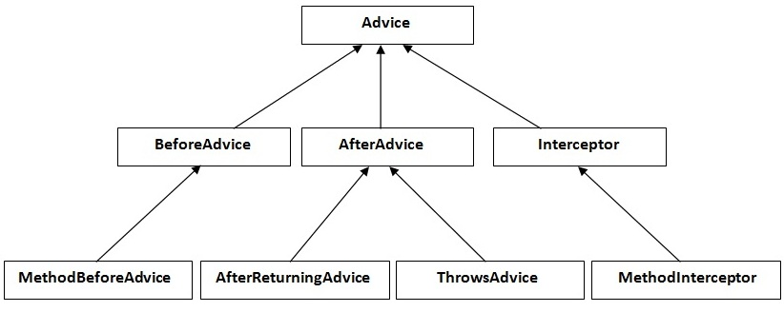
hierarchy of advice interfaces
MethodBeforeAdvice interface extends the BeforeAdvice interface.
AfterReturningAdvice interface extends the AfterAdvice interface.
ThrowsAdvice interface extends the AfterAdvice interface.
MethodInterceptor interface extends the Interceptor interface. It is used in around advice.

Slide 133
1) MethodBeforeAdvice Example
File: A.java
Create a class that contains actual business logic.
package com.javatpoint;
public class A {
public void m(){System.out.println("actual business logic");}
}
File: BeforeAdvisor.java
Now, create the advisor class that implements MethodBeforeAdvice interface.
package com.javatpoint;
import java.lang.reflect.Method;
import org.springframework.aop.MethodBeforeAdvice;
public class BeforeAdvisor implements MethodBeforeAdvice{
@Override
public void before(Method method, Object[] args, Object target)throws Throwable {
System.out.println("additional concern before actual logic");
}
}

Slide 134
File: applicationContext.xml
In xml file, create 3 beans, one for A class, second for Advisor class and third for ProxyFactoryBean class.
<?xml version="1.0" encoding="UTF-8"?>
<beans
xmlns="http://www.springframework.org/schema/beans"
xmlns:xsi="http://www.w3.org/2001/XMLSchema-instance"
xmlns:p="http://www.springframework.org/schema/p"
xsi:schemaLocation="http://www.springframework.org/schema/beans
http://www.springframework.org/schema/beans/spring-beans-3.0.xsd">
<bean id="obj" class="com.javatpoint.A"></bean>
<bean id="ba" class="com.javatpoint.BeforeAdvisor"></bean>
<bean id="proxy" class="org.springframework.aop.framework.ProxyFactoryBean">
<property name="target" ref="obj"></property>
<property name="interceptorNames">
<list>
<value>ba</value>
</list>
</property>
</bean>
</beans>

Slide 135
Understanding ProxyFactoryBean class:
The ProxyFactoryBean class is provided by Spring Famework. It contains 2 properties target and interceptorNames. The instance of A class will be considered as target object and the instance of advisor class as interceptor. You need to pass the advisor object as the list object as in the xml file given above.
public class ProxyFactoryBean{
private Object target;
private List interceptorNames;
//getters and setters
}
Now, let's call the actual method.
File: Test.java
package com.javatpoint;
import org.springframework.beans.factory.BeanFactory;
import org.springframework.beans.factory.xml.XmlBeanFactory;
import org.springframework.core.io.ClassPathResource;
import org.springframework.core.io.Resource;
public class Test {
public static void main(String[] args) {
Resource r=new ClassPathResource("applicationContext.xml");
BeanFactory factory=new XmlBeanFactory(r);
A a=factory.getBean("proxy",A.class);
a.m();
}
}

Slide 136
Printing additional information in MethodBeforeAdvice
We can print additional information like method name, method argument, target object, target object class name, proxy class etc.
You need to change only two classes BeforeAdvisor.java and Test.java.
File: BeforeAdvisor.java
package com.javatpoint;
import java.lang.reflect.Method;
import org.springframework.aop.MethodBeforeAdvice;
public class BeforeAdvisor implements MethodBeforeAdvice{
@Override
public void before(Method method, Object[] args, Object target)throws Throwable {
System.out.println("additional concern before actual logic");
System.out.println("method info:"+method.getName()+" "+method.getModifiers());
System.out.println("argument info:");
for(Object arg:args)
System.out.println(arg);
System.out.println("target Object:"+target);
System.out.println("target object class name: "+target.getClass().getName());
}
}
File: Test.java
package com.javatpoint;
import org.springframework.beans.factory.BeanFactory;
import org.springframework.beans.factory.xml.XmlBeanFactory;
import org.springframework.core.io.ClassPathResource;
import org.springframework.core.io.Resource;
public class Test {
public static void main(String[] args) {
Resource r=new ClassPathResource("applicationContext.xml");
BeanFactory factory=new XmlBeanFactory(r);
A a=factory.getBean("proxy",A.class);
System.out.println("proxy class name: "+a.getClass().getName());
a.m();
}
}

Slide 137
2) AfterReturningAdvice Example
File: A.java
Create a class that contains actual business logic.
Same as in the previous example.
File: AfterAdvisor.java
Now, create the advisor class that implements AfterReturningAdvice interface.
package com.javatpoint;
import java.lang.reflect.Method;
import org.springframework.aop.AfterReturningAdvice;
public class AfterAdvisor implements AfterReturningAdvice{
@Override
public void afterReturning(Object returnValue, Method method,
Object[] args, Object target) throws Throwable {
System.out.println("additional concern after returning advice");
}
}

Slide 138
File: applicationContext.xml
Create the xml file as in the previous example, you need to change only the advisor class here.
<?xml version="1.0" encoding="UTF-8"?>
<beans
xmlns="http://www.springframework.org/schema/beans"
xmlns:xsi="http://www.w3.org/2001/XMLSchema-instance"
xmlns:p="http://www.springframework.org/schema/p"
xsi:schemaLocation="http://www.springframework.org/schema/beans
http://www.springframework.org/schema/beans/spring-beans-3.0.xsd">
<bean id="obj" class="com.javatpoint.A"></bean>
<bean id="ba" class="com.javatpoint.AfterAdvisor"></bean>
<bean id="proxy" class="org.springframework.aop.framework.ProxyFactoryBean">
<property name="target" ref="obj"></property>
<property name="interceptorNames">
<list>
<value>ba</value>
</list>
</property>
</bean>
</beans>
File: Test.java
Same as in the previous example.

Slide 139
3) MethodInterceptor (AroundAdvice) Example
class Testarray2{
File: A.java
Create a class that contains actual business logic.
Same as in the previous example.
Now, create the advisor class that implements MethodInterceptor interface.
File: AroundAdvisor.java
package com.javatpoint;
import org.aopalliance.intercept.MethodInterceptor;
import org.aopalliance.intercept.MethodInvocation;
public class AroundAdvisor implements MethodInterceptor{
@Override
public Object invoke(MethodInvocation mi) throws Throwable {
Object obj;
System.out.println("additional concern before actual logic");
obj=mi.proceed();
System.out.println("additional concern after actual logic");
return obj;
}
}

Slide 140
File: applicationContext.xml
Create the xml file as in the previous example, you need to change only the advisor class here.
<?xml version="1.0" encoding="UTF-8"?>
<beans
xmlns="http://www.springframework.org/schema/beans"
xmlns:xsi="http://www.w3.org/2001/XMLSchema-instance"
xmlns:p="http://www.springframework.org/schema/p"
xsi:schemaLocation="http://www.springframework.org/schema/beans
http://www.springframework.org/schema/beans/spring-beans-3.0.xsd">
<bean id="obj" class="com.javatpoint.A"></bean>
<bean id="ba" class="com.javatpoint.AroundAdvisor"></bean>
<bean id="proxy" class="org.springframework.aop.framework.ProxyFactoryBean">
<property name="target" ref="obj"></property>
<property name="interceptorNames">
<list>
<value>ba</value>
</list>
</property>
</bean>
</beans>
File: Test.java
Same as in the previous example.

Slide 141
4) ThrowsAdvice Example
Create a class that contains actual business logic.
File: Validator.java
package com.javatpoint;
public class Validator {
public void validate(int age)throws Exception{
if(age<18){
throw new ArithmeticException("Not Valid Age");
}
else{
System.out.println("vote confirmed");
}
}
}
Now, create the advisor class that implements ThrowsAdvice interface.
File: ThrowsAdvisor.java
package com.javatpoint;
import org.springframework.aop.ThrowsAdvice;
public class ThrowsAdvisor implements ThrowsAdvice{
public void afterThrowing(Exception ex){
System.out.println("additional concern if exception occurs");
}
}

Slide 142
File: applicationContext.xml
Create the xml file as in the previous example, you need to change only the Validator class and advisor class.
<?xml version="1.0" encoding="UTF-8"?>
<beans
xmlns="http://www.springframework.org/schema/beans"
xmlns:xsi="http://www.w3.org/2001/XMLSchema-instance"
xmlns:p="http://www.springframework.org/schema/p"
xsi:schemaLocation="http://www.springframework.org/schema/beans
http://www.springframework.org/schema/beans/spring-beans-3.0.xsd">
<bean id="obj" class="com.javatpoint.Validator"></bean>
<bean id="ba" class="com.javatpoint.ThrowsAdvisor"></bean>
<bean id="proxy" class="org.springframework.aop.framework.ProxyFactoryBean">
<property name="target" ref="obj"></property>
<property name="interceptorNames">
<list>
<value>ba</value>
</list>
</property>
</bean>
</beans>
File: Test.java
package com.javatpoint;
import org.springframework.beans.factory.BeanFactory;
import org.springframework.beans.factory.xml.XmlBeanFactory;
import org.springframework.core.io.ClassPathResource;
import org.springframework.core.io.Resource;
public class Test {
public static void main(String[] args) {
Resource r=new ClassPathResource("applicationContext.xml");
BeanFactory factory=new XmlBeanFactory(r);
Validator v=factory.getBean("proxy",Validator.class);
try{
v.validate(12);
}catch(Exception e){e.printStackTrace();}
}
}

Slide 143
Spring MVC
A Java framework which is used to build web applications. It follows the Model-View-Controller design pattern. It implements all the basic features of a core spring framework like Inversion of Control, Dependency Injection.
A Spring MVC provides an elegant solution to use MVC in spring framework by the help of DispatcherServlet.
Here, DispatcherServlet is a class that receives the incoming request and maps it to the right resource such as controllers, models, and views.

Slide 144
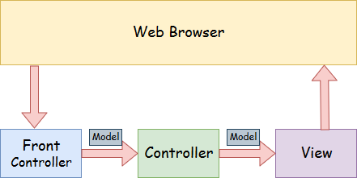
Spring MVC

Slide 145
Spring Web Model-View-Controller
Model - A model contains the data of the application. A data can be a single object or a collection of objects.
Controller - A controller contains the business logic of an application. Here, the @Controller annotation is used to mark the class as the controller.
View - A view represents the provided information in a particular format. Generally, JSP+JSTL is used to create a view page. Although spring also supports other view technologies such as Apache Velocity, Thymeleaf and FreeMarker.
Front Controller - In Spring Web MVC, the DispatcherServlet class works as the front controller. It is responsible to manage the flow of the Spring MVC application.

Slide 146
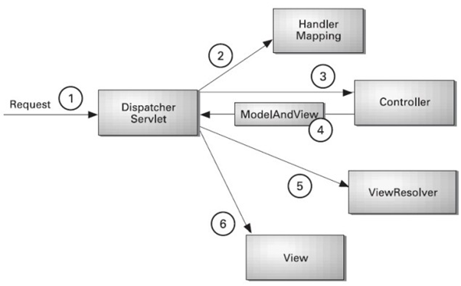
Understanding the flow of Spring Web MVC

Slide 147
Flow of Spring Web MVC
As displayed in the figure, all the incoming request is intercepted by the DispatcherServlet that works as the front controller.
The DispatcherServlet gets an entry of handler mapping from the XML file and forwards the request to the controller.
The controller returns an object of ModelAndView.
The DispatcherServlet checks the entry of view resolver in the XML file and invokes the specified view component.

Slide 148
Advantages of Spring MVC Framework
Separate roles - The Spring MVC separates each role, where the model object, controller, command object, view resolver, DispatcherServlet, validator, etc. can be fulfilled by a specialized object.
Light-weight - It uses light-weight servlet container to develop and deploy your application.
Powerful Configuration - It provides a robust configuration for both framework and application classes that includes easy referencing across contexts, such as from web controllers to business objects and validators.
Rapid development - The Spring MVC facilitates fast and parallel development.
Reusable business code - Instead of creating new objects, it allows us to use the existing business objects.
Easy to test - In Spring, generally we create JavaBeans classes that enable you to inject test data using the setter methods.
Flexible Mapping - It provides the specific annotations that easily redirect the page.

Slide 149
Spring Web MVC Framework Example
Load the spring jar files or add dependencies in the case of Maven
Create the controller class
Provide the entry of controller in the web.xml file
Define the bean in the separate XML file
Display the message in the JSP page
Start the server and deploy the project

Slide 150
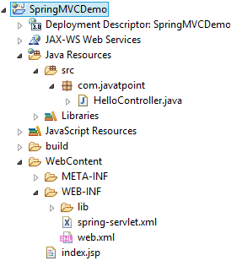
Directory Structure of Spring MVC

Slide 151
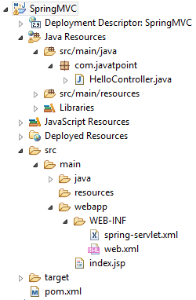
Directory Structure of Spring MVC using Maven

Slide 152
Required Jar files or Maven Dependency
To run this example, you need to load:
Spring Core jar files
Spring Web jar files
JSP + JSTL jar files (If you are using any another view technology then load the corresponding jar files).
Download Link: Download all the jar files for spring including JSP and JSTL.
If you are using Maven, you don't need to add jar files. Now, you need to add maven dependency to the pom.xml file.

Slide 153
1. Provide project information and configuration in the pom.xml file.
pom.xml
<project xmlns="http://maven.apache.org/POM/4.0.0" xmlns:xsi="http://www.w3.org/2001/XMLSchema-instance"
xsi:schemaLocation="http://maven.apache.org/POM/4.0.0 http://maven.apache.org/maven-v4_0_0.xsd">
<modelVersion>4.0.0</modelVersion>
<groupId>com.javatpoint</groupId>
<artifactId>SpringMVC</artifactId>
<packaging>war</packaging>
<version>0.0.1-SNAPSHOT</version>
<name>SpringMVC Maven Webapp</name>
<url>http://maven.apache.org</url>
<dependencies>
<dependency>
<groupId>junit</groupId>
<artifactId>junit</artifactId>
<version>3.8.1</version>
<scope>test</scope>
</dependency>
<!-- https://mvnrepository.com/artifact/org.springframework/spring-webmvc -->
<dependency>
<groupId>org.springframework</groupId>
<artifactId>spring-webmvc</artifactId>
<version>5.1.1.RELEASE</version>
</dependency>
<!-- https://mvnrepository.com/artifact/javax.servlet/javax.servlet-api -->
<dependency>
<groupId>javax.servlet</groupId>
<artifactId>servlet-api</artifactId>
<version>3.0-alpha-1</version>
</dependency>
</dependencies>
<build>
<finalName>SpringMVC</finalName>
</build>
</project>

Slide 154
2. Create the controller class
To create the controller class, we are using two annotations @Controller and @RequestMapping.
The @Controller annotation marks this class as Controller.
The @Requestmapping annotation is used to map the class with the specified URL name.
HelloController.java
package com.javatpoint;
import org.springframework.stereotype.Controller;
import org.springframework.web.bind.annotation.RequestMapping;
@Controller
public class HelloController {
@RequestMapping("/")
public String display()
{
return "index";
}
}

Slide 155
3. Provide the entry of controller in the web.xml file
In this xml file, we are specifying the servlet class DispatcherServlet that acts as the front controller in Spring Web MVC. All the incoming request for the html file will be forwarded to the DispatcherServlet.
web.xml
<?xml version="1.0" encoding="UTF-8"?>
<web-app xmlns:xsi="http://www.w3.org/2001/XMLSchema-instance" xmlns="http://java.sun.com/xml/ns/javaee" xsi:schemaLocation="http://java.sun.com/xml/ns/javaee http://java.sun.com/xml/ns/javaee/web-app_3_0.xsd" id="WebApp_ID" version="3.0">
<display-name>SpringMVC</display-name>
<servlet>
<servlet-name>spring</servlet-name>
<servlet-class>org.springframework.web.servlet.DispatcherServlet</servlet-class>
<load-on-startup>1</load-on-startup>
</servlet>
<servlet-mapping>
<servlet-name>spring</servlet-name>
<url-pattern>/</url-pattern>
</servlet-mapping>
</web-app>

Slide 156
4. Define the bean in the xml file
This is the important configuration file where we need to specify the View components.
The context:component-scan element defines the base-package where DispatcherServlet will search the controller class.
This xml file should be located inside the WEB-INF directory.
spring-servlet.xml
<?xml version="1.0" encoding="UTF-8"?>
<beans xmlns="http://www.springframework.org/schema/beans"
xmlns:xsi="http://www.w3.org/2001/XMLSchema-instance"
xmlns:context="http://www.springframework.org/schema/context"
xmlns:mvc="http://www.springframework.org/schema/mvc"
xsi:schemaLocation="
http://www.springframework.org/schema/beans
http://www.springframework.org/schema/beans/spring-beans.xsd
http://www.springframework.org/schema/context
http://www.springframework.org/schema/context/spring-context.xsd
http://www.springframework.org/schema/mvc
http://www.springframework.org/schema/mvc/spring-mvc.xsd">
<!-- Provide support for component scanning -->
<context:component-scan base-package="com.javatpoint" />
<!--Provide support for conversion, formatting and validation -->
<mvc:annotation-driven/>
</beans>

Slide 157
5. Display the message in the JSP page
This is the simple JSP page, displaying the message returned by the Controller.
index.jsp
<html>
<body>
<p>Welcome to Spring MVC Tutorial</p>
</body>
</html>

Slide 158
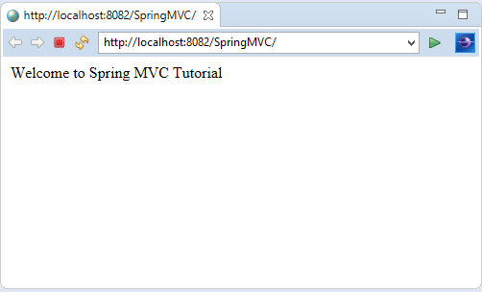
Output

Slide 159
Spring MVC Multiple View page Example
Here, we redirect a view page to another view page.
Let's see the simple example of a Spring Web MVC framework. The steps are as follows:
Load the spring jar files or add dependencies in the case of Maven
Create the controller class
Provide the entry of controller in the web.xml file
Define the bean in the separate XML file
Create the other view components
Start the server and deploy the project

Slide 160
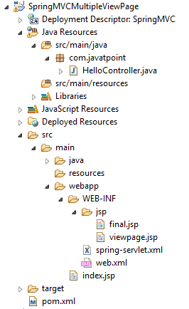
Directory Structure of Spring MVC

Slide 161
1. Add dependencies to pom.xml
<!-- https://mvnrepository.com/artifact/org.springframework/spring-webmvc -->
<dependency>
<groupId>org.springframework</groupId>
<artifactId>spring-webmvc</artifactId>
<version>5.1.1.RELEASE</version>
</dependency>
<!-- https://mvnrepository.com/artifact/javax.servlet/javax.servlet-api -->
<dependency>
<groupId>javax.servlet</groupId>
<artifactId>servlet-api</artifactId>
<version>3.0-alpha-1</version>
</dependency>

Slide 162
2. Create the request page
Let's create a simple jsp page containing a link.
index.jsp
<html>
<body>
<a href="hello">Click here...</a>
</body>
</html>

Slide 163
3. Create the controller class
Let's create a controller class that returns the JSP pages. Here, we pass the specific name with a @Requestmapping annotation to map the class.
HelloController.java
package com.javatpoint;
import org.springframework.stereotype.Controller;
import org.springframework.web.bind.annotation.RequestMapping;
@Controller
public class HelloController {
@RequestMapping("/hello")
public String redirect()
{
return "viewpage";
}
@RequestMapping("/helloagain")
public String display()
{
return "final";
}
}

Slide 164
4. Provide the entry of controller in the web.xml file
web.xml
<?xml version="1.0" encoding="UTF-8"?>
<web-app xmlns:xsi="http://www.w3.org/2001/XMLSchema-instance" xmlns="http://java.sun.com/xml/ns/javaee" xsi:schemaLocation="http://java.sun.com/xml/ns/javaee http://java.sun.com/xml/ns/javaee/web-app_3_0.xsd" id="WebApp_ID" version="3.0">
<display-name>SpringMVC</display-name>
<servlet>
<servlet-name>spring</servlet-name>
<servlet-class>org.springframework.web.servlet.DispatcherServlet</servlet-class>
<load-on-startup>1</load-on-startup>
</servlet>
<servlet-mapping>
<servlet-name>spring</servlet-name>
<url-pattern>/</url-pattern>
</servlet-mapping>
</web-app>

Slide 165
5. Define the bean in the xml file
Now, we also provide view resolver with view component.
Here, the InternalResourceViewResolver class is used for the ViewResolver.
The prefix+string returned by controller+suffix page will be invoked for the view component.
This xml file should be located inside the WEB-INF directory.
spring-servlet.xml
<?xml version="1.0" encoding="UTF-8"?>
<beans xmlns="http://www.springframework.org/schema/beans"
xmlns:xsi="http://www.w3.org/2001/XMLSchema-instance"
xmlns:context="http://www.springframework.org/schema/context"
xmlns:mvc="http://www.springframework.org/schema/mvc"
xsi:schemaLocation="
http://www.springframework.org/schema/beans
http://www.springframework.org/schema/beans/spring-beans.xsd
http://www.springframework.org/schema/context
http://www.springframework.org/schema/context/spring-context.xsd
http://www.springframework.org/schema/mvc
http://www.springframework.org/schema/mvc/spring-mvc.xsd">
<!-- Provide support for component scanning -->
<context:component-scan base-package="com.javatpoint" />
<!--Provide support for conversion, formatting and validation -->
<mvc:annotation-driven/>
<!-- Define Spring MVC view resolver -->
<bean id="viewResolver" class="org.springframework.web.servlet.view.InternalResourceViewResolver">
<property name="prefix" value="/WEB-INF/jsp/"></property>
<property name="suffix" value=".jsp"></property>
</bean>
</beans>

Slide 166
6. Create the other view components
viewpage.jsp
<html>
<body>
<a href="helloagain">Javatpoint Tutorials</a>
</body>
</html>
final.jsp
<html>
<body>
<p>Welcome to Spring MVC Tutorial</p>
</body>
</html>

Slide 167
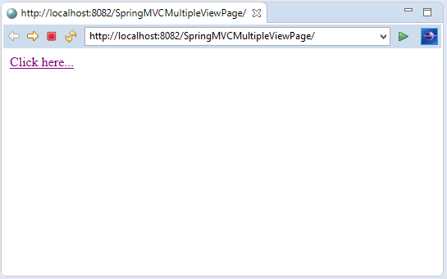
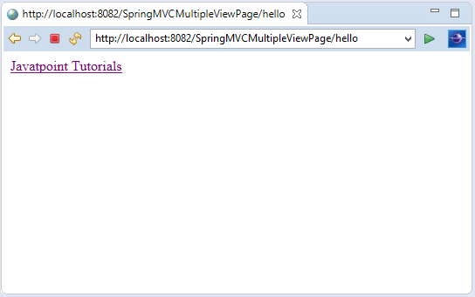
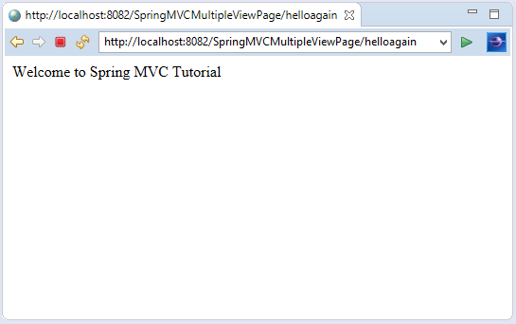
Output:

Slide 168
Spring MVC Multiple Controller Example
In Spring MVC, we can create multiple controllers at a time. It is required to map each controller class with @Controller annotation. Here, we see a Spring MVC example of multiple controllers. The steps are as follows:
Load the spring jar files or add dependencies in the case of Maven
Create the controller class
Provide the entry of controller in the web.xml file
Define the bean in the separate XML file
Create the other view components
Start the server and deploy the project

Slide 169
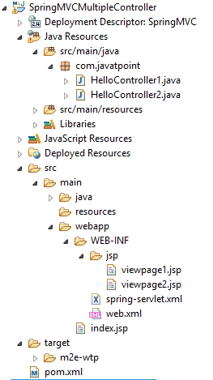
Directory Structure of Spring MVC

Slide 170
1. Add dependencies to pom.xml
<!-- https://mvnrepository.com/artifact/org.springframework/spring-webmvc -->
<dependency>
<groupId>org.springframework</groupId>
<artifactId>spring-webmvc</artifactId>
<version>5.1.1.RELEASE</version>
</dependency>
<!-- https://mvnrepository.com/artifact/javax.servlet/javax.servlet-api -->
<dependency>
<groupId>javax.servlet</groupId>
<artifactId>servlet-api</artifactId>
<version>3.0-alpha-1</version>
</dependency>

Slide 171
2. Create the request page
Let's create a simple JSP page containing two links.
index.jsp
<html>
<body>
<a href="hello1">Spring MVC</a> ||
<a href="hello2">Spring Boot</a>
</body>
</html>
3. Create the controller class
Let's create two controller classes, where each returns the particular view page.
HelloController1.java
package com.javatpoint;
import org.springframework.stereotype.Controller;
import org.springframework.web.bind.annotation.RequestMapping;
@Controller
public class HelloController1 {
@RequestMapping("/hello1")
public String display()
{
return "viewpage1";
}
}
HelloController2.java
package com.javatpoint;
import org.springframework.stereotype.Controller;
import org.springframework.web.bind.annotation.RequestMapping;
@Controller
public class HelloController2 {
@RequestMapping("/hello2")
public String display()
{
return "viewpage2";
}
}

Slide 172
4. Provide the entry of controller in the web.xml file
web.xml
<?xml version="1.0" encoding="UTF-8"?>
<web-app xmlns:xsi="http://www.w3.org/2001/XMLSchema-instance" xmlns="http://java.sun.com/xml/ns/javaee" xsi:schemaLocation="http://java.sun.com/xml/ns/javaee http://java.sun.com/xml/ns/javaee/web-app_3_0.xsd" id="WebApp_ID" version="3.0">
<display-name>SpringMVC</display-name>
<servlet>
<servlet-name>spring</servlet-name>
<servlet-class>org.springframework.web.servlet.DispatcherServlet</servlet-class>
<load-on-startup>1</load-on-startup>
</servlet>
<servlet-mapping>
<servlet-name>spring</servlet-name>
<url-pattern>/</url-pattern>
</servlet-mapping>
</web-app>

Slide 173
5. Define the bean in the xml file
spring-servlet.xml
<?xml version="1.0" encoding="UTF-8"?>
<beans xmlns="http://www.springframework.org/schema/beans"
xmlns:xsi="http://www.w3.org/2001/XMLSchema-instance"
xmlns:context="http://www.springframework.org/schema/context"
xmlns:mvc="http://www.springframework.org/schema/mvc"
xsi:schemaLocation="
http://www.springframework.org/schema/beans
http://www.springframework.org/schema/beans/spring-beans.xsd
http://www.springframework.org/schema/context
http://www.springframework.org/schema/context/spring-context.xsd
http://www.springframework.org/schema/mvc
http://www.springframework.org/schema/mvc/spring-mvc.xsd">
<!-- Provide support for component scanning -->
<context:component-scan base-package="com.javatpoint" />
<!--Provide support for conversion, formatting and validation -->
<mvc:annotation-driven/>
<bean id="viewResolver" class="org.springframework.web.servlet.view.InternalResourceViewResolver">
<property name="prefix" value="/WEB-INF/jsp/"></property>
<property name="suffix" value=".jsp"></property>
</bean>
</beans>

Slide 174
6. Create the other view components
viewpage1.jsp
<html>
<body>
<p>Welcome to Spring MVC Tutorial</p>
</body>
</html>
viewpage1.jsp
<html>
<body>
<p>Welcome to Spring Boot Tutorial</p>
</body>
</html>

Slide 175
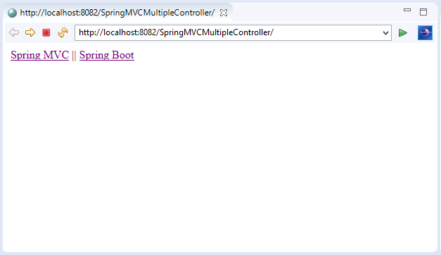
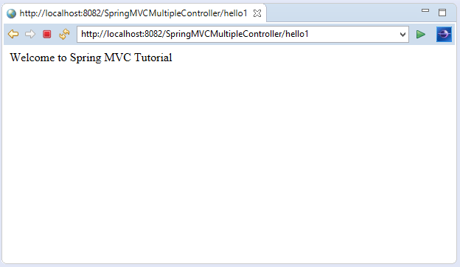
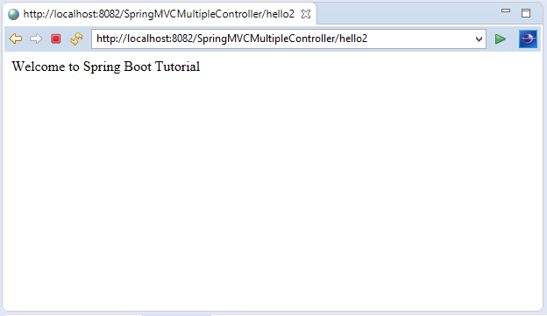
Output:

Slide 176
Spring MVC Model Interface
In Spring MVC, the model works a container that contains the data of the application. Here, a data can be in any form such as objects, strings, information from the database, etc.
It is required to place the Model interface in the controller part of the application. The object of HttpServletRequest reads the information provided by the user and pass it to the Model interface. Now, a view page easily accesses the data from the model part.

Slide 177
Methods of Model Interface
Method | Description
Model addAllAttributes(Collection<?> arg) | It adds all the attributes in the provided Collection into this Map.
Model addAllAttributes(Map<String,?> arg) | It adds all the attributes in the provided Map into this Map.
Model addAllAttribute(Object arg) | It adds the provided attribute to this Map using a generated name.
Model addAllAttribute(String arg0, Object arg1) | It binds the attribute with the provided name.
Map<String, Object> asMap() | It return the current set of model attributes as a Map.
Model mergeAttributes(Map< String,?> arg) | It adds all attributes in the provided Map into this Map, with existing objects of the same name taking precedence.
boolean containsAttribute(String arg) | It indicates whether this model contains an attribute of the given name

Slide 178
Spring MVC Model Example
Let's create a login page that contains a username and password. Here, we validate the password with a specific value.
1. Add dependencies to pom.xml
<!-- https://mvnrepository.com/artifact/org.springframework/spring-webmvc -->
<dependency>
<groupId>org.springframework</groupId>
<artifactId>spring-webmvc</artifactId>
<version>5.1.1.RELEASE</version>
</dependency>
<!-- https://mvnrepository.com/artifact/javax.servlet/javax.servlet-api -->
<dependency>
<groupId>javax.servlet</groupId>
<artifactId>servlet-api</artifactId>
<version>3.0-alpha-1</version>
</dependency>

Slide 179
2. Create the request page
Here, we create the login page to receive name and password from the user.
index.jsp
<html>
<body>
<form action="hello">
UserName : <input type="text" name="name"/> <br><br>
Password : <input type="text" name="pass"/> <br><br>
<input type="submit" name="submit">
</form>
</body>
</html>

Slide 180
3. Create the controller class
In controller class:
The HttpServletRequest is used to read the HTML form data provided by the user.
The Model contains the request data and provides it to view page.
HelloController.java
package com.javatpoint;
import javax.servlet.http.HttpServletRequest;
import org.springframework.stereotype.Controller;
import org.springframework.ui.Model;
import org.springframework.web.bind.annotation.RequestMapping;
@Controller
public class HelloController {
@RequestMapping("/hello")
public String display(HttpServletRequest req,Model m)
{
//read the provided form data
String name=req.getParameter("name");
String pass=req.getParameter("pass");
if(pass.equals("admin"))
{
String msg="Hello "+ name;
//add a message to the model
m.addAttribute("message", msg);
return "viewpage";
}
else
{
String msg="Sorry "+ name+". You entered an incorrect password";
m.addAttribute("message", msg);
return "errorpage";
}
}
}

Slide 181
4. Provide the entry of controller in the web.xml file
web.xml
<?xml version="1.0" encoding="UTF-8"?>
<web-app xmlns:xsi="http://www.w3.org/2001/XMLSchema-instance" xmlns="http://java.sun.com/xml/ns/javaee" xsi:schemaLocation="http://java.sun.com/xml/ns/javaee http://java.sun.com/xml/ns/javaee/web-app_3_0.xsd" id="WebApp_ID" version="3.0">
<display-name>SpringMVC</display-name>
<servlet>
<servlet-name>spring</servlet-name>
<servlet-class>org.springframework.web.servlet.DispatcherServlet</servlet-class>
<load-on-startup>1</load-on-startup>
</servlet>
<servlet-mapping>
<servlet-name>spring</servlet-name>
<url-pattern>/</url-pattern>
</servlet-mapping>
</web-app>

Slide 182
5. Define the bean in the xml file
spring-servlet.xml
<?xml version="1.0" encoding="UTF-8"?>
<beans xmlns="http://www.springframework.org/schema/beans"
xmlns:xsi="http://www.w3.org/2001/XMLSchema-instance"
xmlns:context="http://www.springframework.org/schema/context"
xmlns:mvc="http://www.springframework.org/schema/mvc"
xsi:schemaLocation="
http://www.springframework.org/schema/beans
http://www.springframework.org/schema/beans/spring-beans.xsd
http://www.springframework.org/schema/context
http://www.springframework.org/schema/context/spring-context.xsd
http://www.springframework.org/schema/mvc
http://www.springframework.org/schema/mvc/spring-mvc.xsd">
<!-- Provide support for component scanning -->
<context:component-scan base-package="com.javatpoint" />
<!--Provide support for conversion, formatting and validation -->
<mvc:annotation-driven/>
<bean id="viewResolver" class="org.springframework.web.servlet.view.InternalResourceViewResolver">
<property name="prefix" value="/WEB-INF/jsp/"></property>
<property name="suffix" value=".jsp"></property>
</bean>
</beans>

Slide 183
6. Create the other view components
To run this example, the following view components must be located inside the WEB-INF/jsp directory.
viewpage.jsp
<html>
<body>
${message}
</body>
</html>
errorpage.jsp
<html>
<body>
${message}
<br><br>
<jsp:include page="/index.jsp"></jsp:include>
</body>
</html>

Slide 184
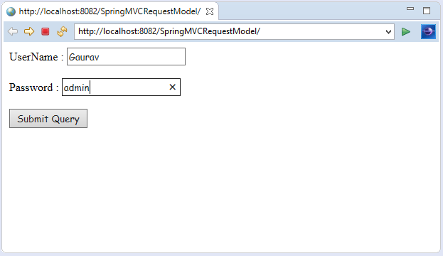
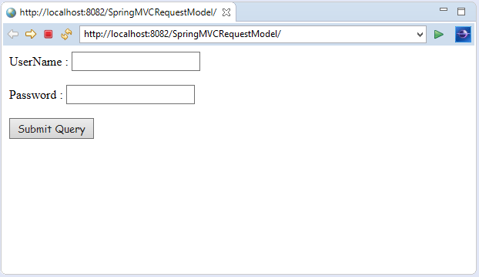
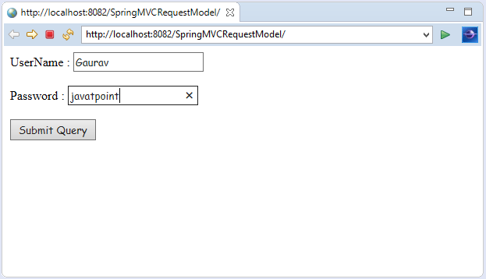
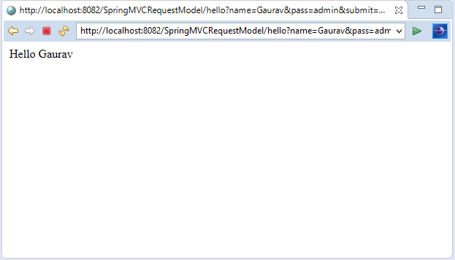
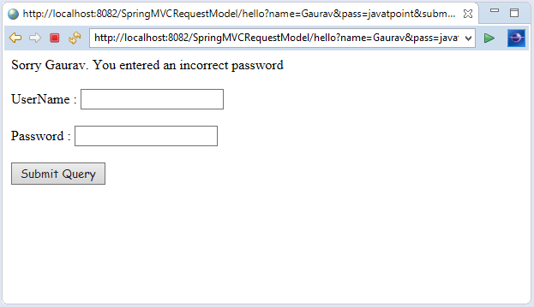
Output:

Slide 185
Spring MVC RequestParam Annotation
In Spring MVC, the @RequestParam annotation is used to read the form data and bind it automatically to the parameter present in the provided method. So, it ignores the requirement of HttpServletRequest object to read the provided data.
Including form data, it also maps the request parameter to query parameter and parts in multipart requests. If the method parameter type is Map and a request parameter name is specified, then the request parameter value is converted to a Map else the map parameter is populated with all request parameter names and values.

Slide 186
Spring MVC RequestParam Example
Let's create a login page that contains a username and password. Here, we validate the password with a specific value.
1. Add dependencies to pom.xml
<!-- https://mvnrepository.com/artifact/org.springframework/spring-webmvc -->
<dependency>
<groupId>org.springframework</groupId>
<artifactId>spring-webmvc</artifactId>
<version>5.1.1.RELEASE</version>
</dependency>
<!-- https://mvnrepository.com/artifact/javax.servlet/javax.servlet-api -->
<dependency>
<groupId>javax.servlet</groupId>
<artifactId>servlet-api</artifactId>
<version>3.0-alpha-1</version>
</dependency>

Slide 187
2. Create the request page
It is the login page that receive name and password from the user.
index.jsp
<html>
<body>
<form action="hello">
UserName : <input type="text" name="name"/> <br><br>
Password : <input type="text" name="pass"/> <br><br>
<input type="submit" name="submit">
</form>
</body>
</html>

Slide 188
3. Create the Controller Class
In controller class:
The @RequestParam is used to read the HTML form data provided by a user and bind it to the request parameter.
The Model contains the request data and provides it to view page.
HelloController.java
package com.javatpoint;
import org.springframework.stereotype.Controller;
import org.springframework.ui.Model;
import org.springframework.web.bind.annotation.RequestMapping;
import org.springframework.web.bind.annotation.RequestParam;
@Controller
public class HelloController {
@RequestMapping("/hello")
//read the provided form data
public String display(@RequestParam("name") String name,@RequestParam("pass") String pass,Model m)
{
if(pass.equals("admin"))
{
String msg="Hello "+ name;
//add a message to the model
m.addAttribute("message", msg);
return "viewpage";
}
else
{
String msg="Sorry "+ name+". You entered an incorrect password";
m.addAttribute("message", msg);
return "errorpage";
}
}
}

Slide 189
4. Create the other view components
To run this example, the following view components must be located inside the WEB-INF/jsp directory.
viewpage.jsp
<html>
<body>
${message}
</body>
</html>
errorpage.jsp
<html>
<body>
${message}
<br><br>
<jsp:include page="/index.jsp"></jsp:include>
</body>
</html>
</html>

Slide 190

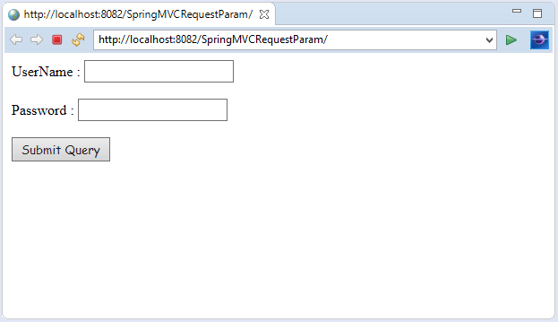
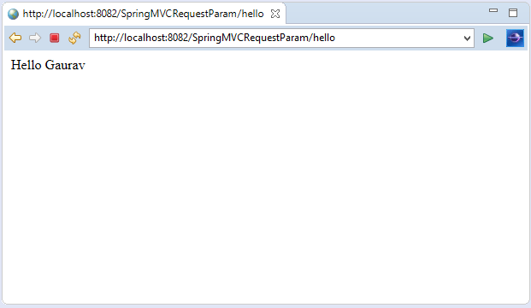
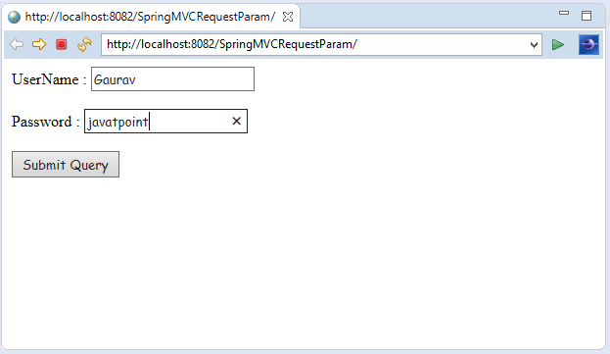
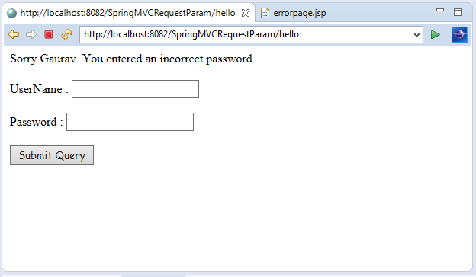
OUTPUT:

Slide 191
RESTful Web Services -Introduction
REST stands for REpresentational State Transfer. It is developed by Roy Thomas Fielding, who also developed HTTP. The main goal of RESTful web services is to make web services more effective. RESTful web services try to define services using the different concepts that are already present in HTTP. REST is an architectural approach, not a protocol.
It does not define the standard message exchange format. We can build REST services with both XML and JSON. JSON is more popular format with REST. The key abstraction is a resource in REST. A resource can be anything. It can be accessed through a Uniform Resource Identifier (URI). For example:
The resource has representations like XML, HTML, and JSON. The current state capture by representational resource. When we request a resource, we provide the representation of the resource. The important methods of HTTP are:
GET: It reads a resource.
PUT: It updates an existing resource.
POST: It creates a new resource.
DELETE: It deletes the resource.

Slide 192
social media application
, we get the corresponding results.
POST /users: It creates a user.
GET /users/{id}: It retrieves the detail of a user.
GET /users: It retrieves the detail of all users.
DELETE /users: It deletes all users.
DELETE /users/{id}: It deletes a user.
GET /users/{id}/posts/post_id: It retrieve the detail of a specific post.
POST / users/{id}/ posts: It creates a post of the user.

Slide 193
HTTP Status code
404: RESOURCE NOT FOUND
200: SUCCESS
201: CREATED
401: UNAUTHORIZED
500: SERVER ERROR

Slide 194
RESTful Service Constraints
There must be a service producer and service consumer.
The service is stateless.
The service result must be cacheable.
The interface is uniform and exposing resources.
The service should assume a layered architecture.

Slide 195
Advantages of RESTful web services
RESTful web services are platform-independent.
It can be written in any programming language and can be executed on any platform.
It provides different data format like JSON, text, HTML, and XML.
It is fast in comparison to SOAP because there is no strict specification like SOAP.
These are reusable.
They are language neutral.

Slide 196
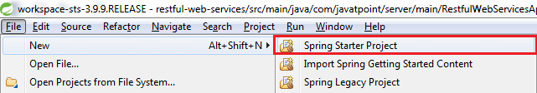
Initializing a RESTful Web Services Project with Spring Boot
Step 1: Download the Spring Tool Suite (STS) from https://spring.io/tools3/sts/all and extract it.
Step 2: Launch the STS.
Step 3: Click on File menu -> New -> Spring Starter Project ->

Slide 197
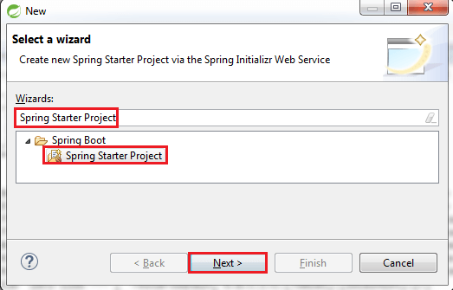
If the Spring Starter Project is not enlisted, then click on Other at the bottom of the menu. A dialog box appears on the screen. Type Spring Starter Project in the Wizards text box and click on the Next button.

Slide 198
Step 4: provide the name, group, and package of the project. We have provided:
Name: restful-web-services
Group: com.javatpoint
Package: com.javatpoint.server.main
Click on the Next button.

Slide 199
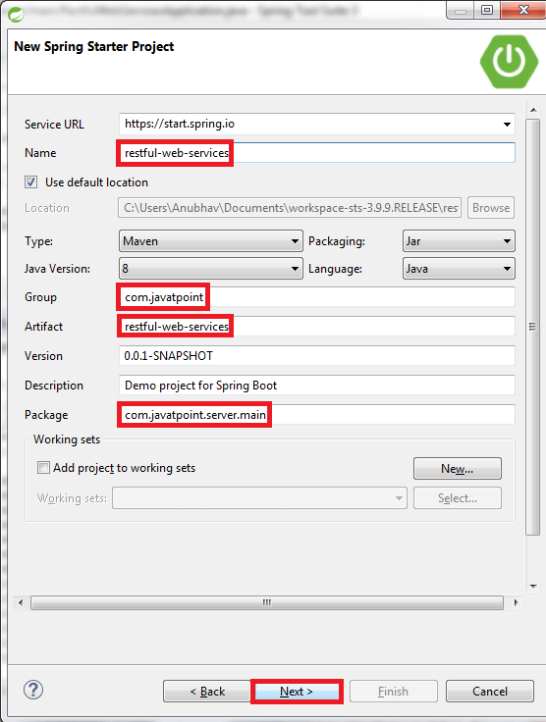

Slide 200
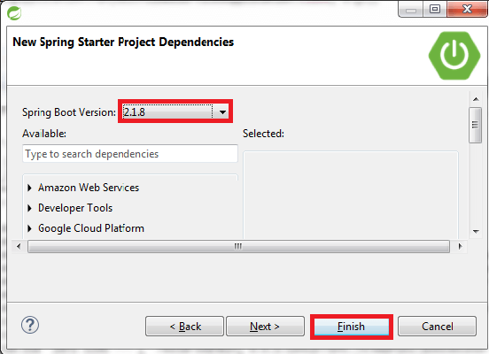
Step 5: Choose the Spring Boot Version 2.1.8.

Slide 201
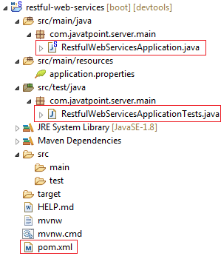
Step 6: We can see the project structure in the project explorer window.

Slide 202
Step 7:
Go to the Maven Repository https://mvnrepository.com/ and add Spring Web MVC, Spring Boot DevTools, JPA, and H2 dependencies in the pom.xml. After adding the dependencies, the pom.xml file looks like the following:
pom.xml
<project xmlns="http://maven.apache.org/POM/4.0.0"
xmlns:xsi="http://www.w3.org/2001/XMLSchema-instance"
xsi:schemaLocation="http://maven.apache.org/POM/4.0.0
http://maven.apache.org/xsd/maven-4.0.0.xsd">
<modelVersion>4.0.0</modelVersion>
<parent>
<groupId>org.springframework.boot</groupId>
<artifactId>spring-boot-starter-parent</artifactId>
<version>2.1.8.RELEASE</version>
<relativePath/> <!-- lookup parent from repository -->
</parent>
<groupId>com.javatpoint</groupId>
<artifactId>restful-web-services</artifactId>
<version>0.0.1-SNAPSHOT</version>
<name>restful-web-services</name>
<description>Demo project for Spring Boot</description>
<properties>
<java.version>1.8</java.version>
</properties>
<dependencies>
<dependency>
<groupId>org.springframework.boot</groupId>
<artifactId>spring-boot-starter</artifactId>
</dependency>
<dependency>
<groupId>org.springframework.boot</groupId>
<artifactId>spring-boot-starter-activemq</artifactId>
</dependency>
<dependency>
<groupId>org.springframework.boot</groupId>
<artifactId>spring-boot-starter-web</artifactId>
</dependency>
<dependency>
<groupId>org.springframework.boot</groupId>
<artifactId>spring-boot-starter-tomcat</artifactId>
</dependency>
<dependency>
<groupId>org.springframework</groupId>
<artifactId>spring-webmvc</artifactId>
</dependency>
<!-- https://mvnrepository.com/artifact/org.springframework.boot/spring-boot-devtools -->
<dependency>
<groupId>org.springframework.boot</groupId>
<artifactId>spring-boot-devtools</artifactId>
<scope>runtime</scope>
</dependency>
<!-- https://mvnrepository.com/artifact/org.hibernate.javax.persistence/hibernate-jpa-2.1-api -->
<dependency>
<groupId>org.hibernate.javax.persistence</groupId>
<artifactId>hibernate-jpa-2.1-api</artifactId>
<version>1.0.0.Final</version>
</dependency>
<!-- https://mvnrepository.com/artifact/com.h2database/h2 -->
<dependency>
<groupId>com.h2database</groupId>
<artifactId>h2</artifactId>
<scope>runtime</scope>
</dependency>
<dependency>
<groupId>org.apache.maven</groupId>
<artifactId>maven-archiver</artifactId>
<version>2.5</version>
</dependency>
<dependency>
<groupId>org.springframework.boot</groupId>
<artifactId>spring-boot-starter-test</artifactId>
<scope>test</scope>
</dependency>
</dependencies>
<build>
<plugins>
<plugin>
<groupId>org.springframework.boot</groupId>
<artifactId>spring-boot-maven-plugin</artifactId>
</plugin>
</plugins>
</build>
</project>

Slide 203
Step 8
Now open the RestfulWebServicesApplication.java file and Run the file as Java Application.
package com.javatpoint.server.main;
import org.springframework.boot.SpringApplication;
import org.springframework.boot.autoconfigure.SpringBootApplication;
@SpringBootApplication
public class RestfulWebServicesApplication
{
public static void main(String[] args)
{
SpringApplication.run(RestfulWebServicesApplication.class, args);
}
}
It does not perform any service but ensures that the application is running properly.

Slide 204
Output

Slide 205
Creating a Hello World Service
Step 1: Create a new class with the name HelloWorldController in the package com.javatpoint.server.main.
Step 2: Whenever we create a web service, we need to define two things Get method and the URI. Now create the helloWorld() method which returns the string "Hello World." If we want to tell the spring MVC that it is going to handle the REST request, we have to add @RestController annotation. Now it becomes a rest controller which can handle the Rest request.
The next thing we have to do is create a mapping for the method. Add @RequestMapping annotation just above the helloWorld() method.

Slide 206
HelloWorldController
The HelloWorldController looks like the following:
package com.javatpoint.server.main;
import org.springframework.web.bind.annotation.RequestMapping;
import org.springframework.web.bind.annotation.RequestMethod;
import org.springframework.web.bind.annotation.RestController;
//Controller
@RestController
public class HelloWorldController
{
//using get method and hello-world as URI
@RequestMapping(method=RequestMethod.GET, path="/hello-world")
public String helloWorld()
{
return "Hello World";
}
}

Slide 207
@GetMapping annotation instead of @RequestMapping.
We can also improve the above code by using the @GetMapping annotation instead of @RequestMapping. Here the method specification is not required.
package com.javatpoint.server.main;
import org.springframework.web.bind.annotation.GetMapping;
import org.springframework.web.bind.annotation.RestController;
//Controller
@RestController
public class HelloWorldController
{
//using get method and hello-world as URI
@GetMapping(path="/hello-world")
public String helloWorld()
{
return "Hello World";
}
}
Step 3: Run the RestfulWebServiceApplication. It displays the string Hello World on the browser.

Slide 208
Enhancing the Hello World Service to Return a Bean
In this section, we are going to generate a bean for the method helloWorld().
Step 1: Create a helloWorldBean() method in HelloWordController.java file. Map the URI to "/hello-world-bean" and return HelloWorldBean.
HelloWorldController.java
package com.javatpoint.server.main;
import org.springframework.web.bind.annotation.GetMapping;
import org.springframework.web.bind.annotation.RestController;
//Controller
@RestController
public class HelloWorldController
{
//using get method and hello-world URI
@GetMapping(path="/hello-world")
public String helloWorld()
{
return "Hello World";
}
@GetMapping(path="/hello-world-bean")
public HelloWorldBean helloWorldBean()
{
return new HelloWorldBean("Hello World"); //constructor of HelloWorldBean
}
}

Slide 209
Step 2: Create a class HelloWorldBean.
Step 3: Generate Getters and Setters.
Right-click -> Source -> Generate Getters and Setters -> check the box -> Ok
Step 4: Generate toString()..
Right-click -> Source -> Generate toString().. -> Ok

Slide 210
HelloWorldBean.java
package com.javatpoint.server.main;
public class HelloWorldBean
{
public String message;
//constructor of HelloWorldBean
public HelloWorldBean(String message)
{
this.message=message;
}
//generating getters and setters
public String getMessage()
{
return message;
}
public void setMessage(String message)
{
this.message = message;
}
@Override
//generate toString
public String toString()
{
return String.format ("HelloWorldBean [message=%s]", message);
}
}
Step 5: Launch the HelloWorldController. The URL of the browser changes to localhost:8080/hello-world-bean.
It returns the message "Hello World" in JSON format.
{
message: "Hello World"
}

